Slide 1
ECEN 5283 Project 3: Texture Classification
Alexander Rose
Oklahoma State University
3/18/2024

Slide 2
Objective
For this project, students are given 59 texture images
Feature vectors are calculated by extracting certain statistics (mean, variance, skewness, kurtosis) from the textures after two different methods of texture processing:
Laplacian Pyramid
Gabor Filter Bank
A percentage of correct classification (PCC) is calculated from the results to evaluate the filter performance under different statistic combinations.

Slide 3
Technical Background
Texture representation is a part of early vision in the visual cortex
Textures are filtered and statistics measured such as mean, variance, skewness, and kurtosis to create texture banks.
An unknown texture’s statistics are measured and compared to identify it’s classification
Filter scale plays an important role in texture analysis.
Smaller filters have better special resolution
Larger filters have better robustness
Two texture classification methods are introduced and implemented in this project: Laplacian pyramid; Gabor filter.

Slide 4
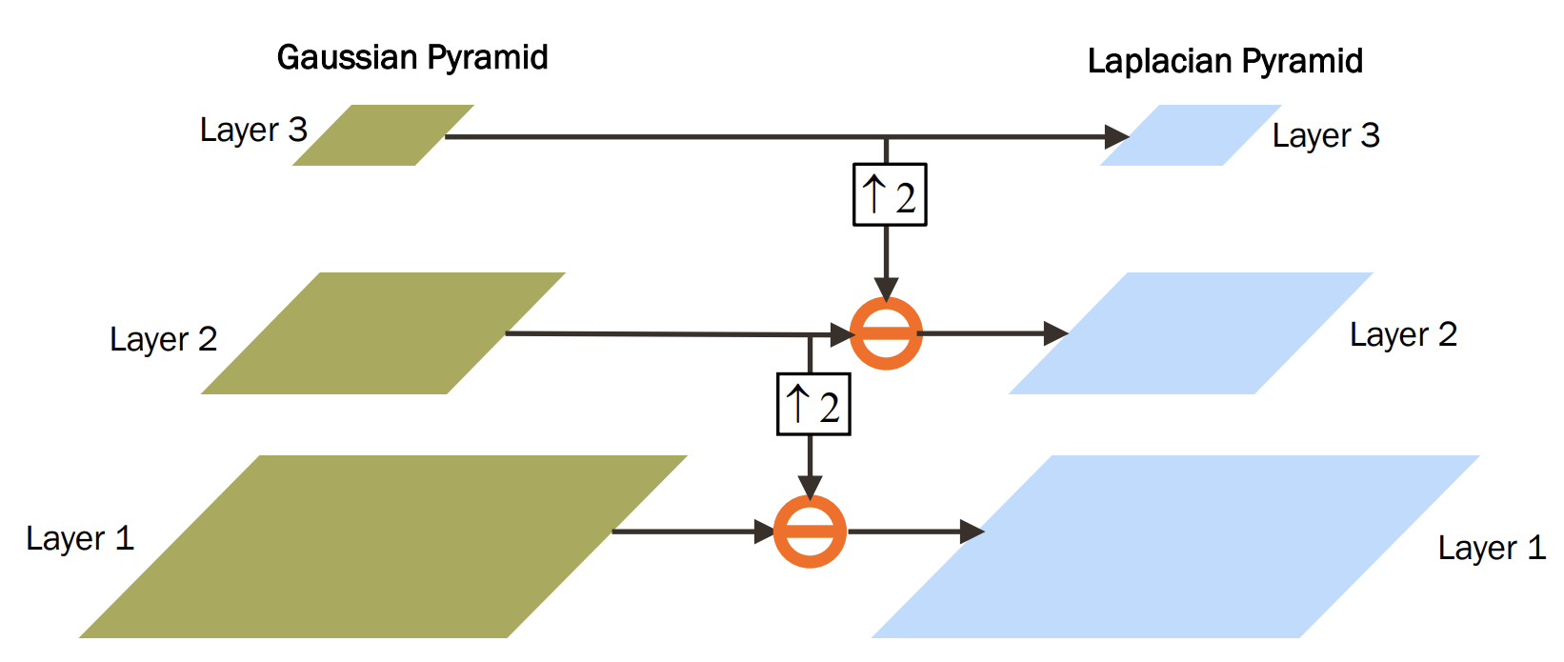
Technical Background – Laplacian
The Laplacian pyramid is a form of multi scale image representation
First, a Gaussian filter is created and implemented at different scales
The smallest layer of the Gaussian pyramid is up-sampled and subtracted from the next layer down. The result is the Laplacian layer.
Thus, the Laplacian pyramid
contains only the difference
between the two layers,
except at the smallest layer.
Example in next slide and in
experiment results

Slide 5
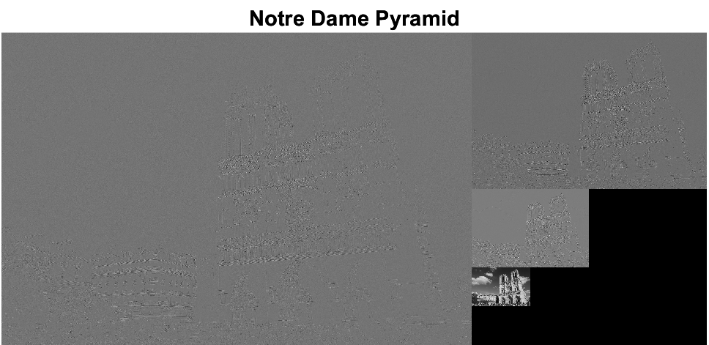
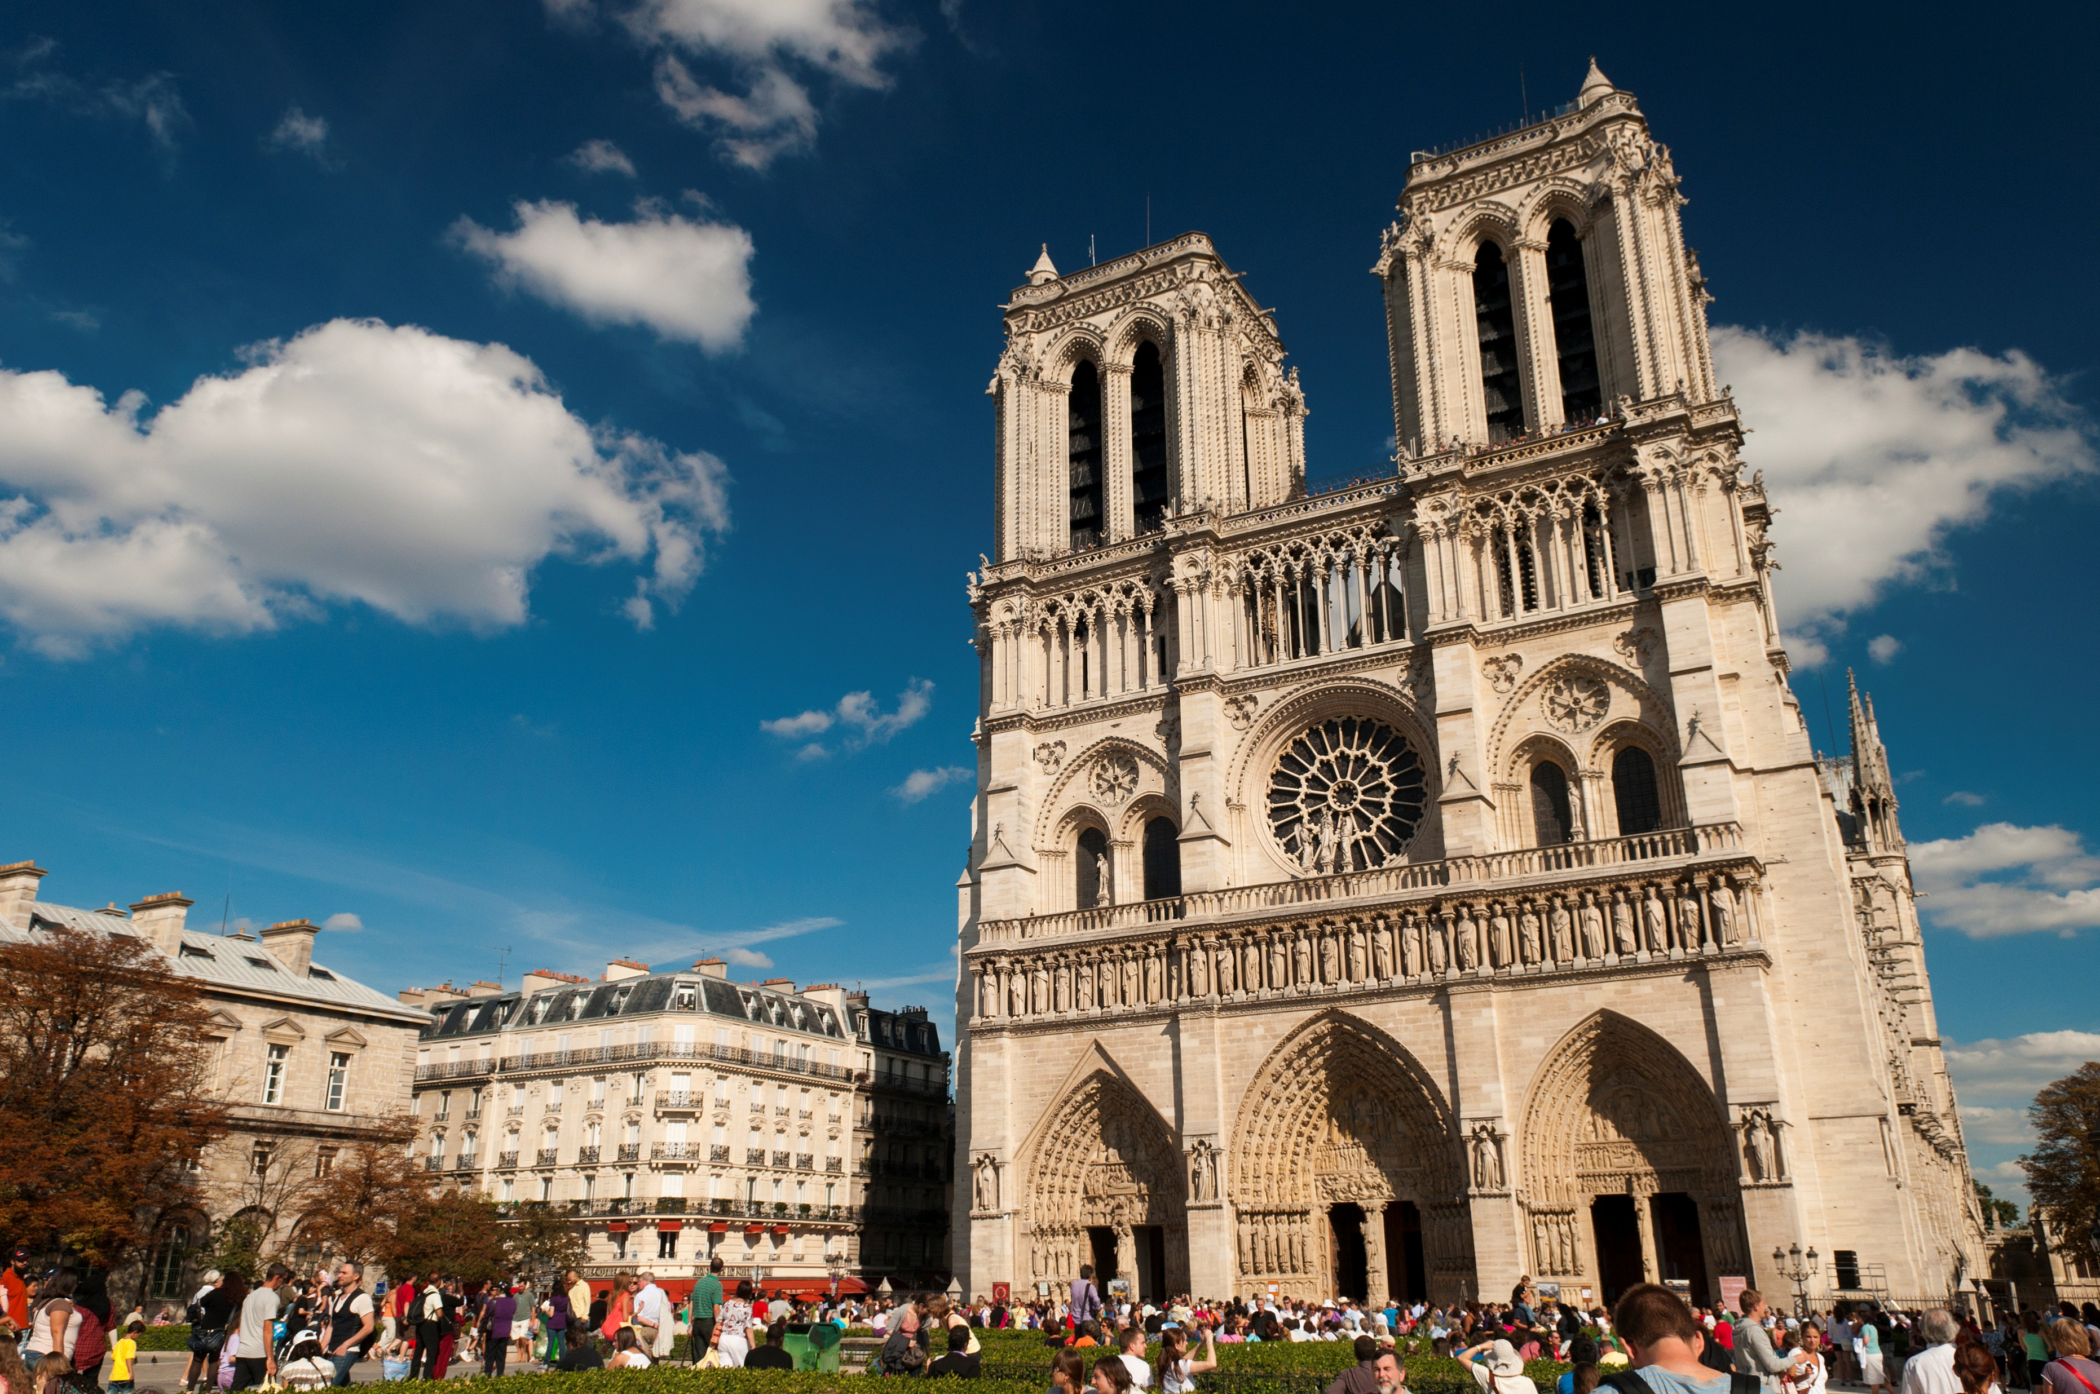
This is an example of a Laplacian pyramid applied to a photo of Notre Dame. Better examples are shown in the experiment results section. This example was mostly just for fun. Photo is creative commons licensed.

Slide 6
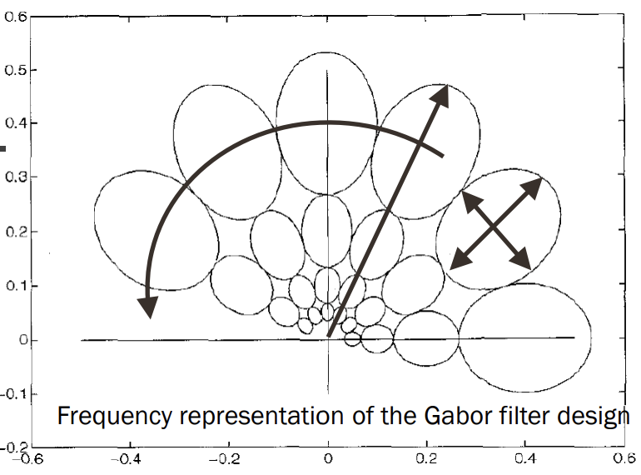
Technical Background – Gabor
The Gabor filter is a bank of filters where the number of filters is equal to the number of scales and orientations of a gaussian filter.
These filters provide good special selectivity compared to a Fourier basis which has no special selectivity
The Gabor has poorer frequency selectivity
The Gabor prioritizes low frequency textures over high frequency since high frequency is difficult for humans to perceive
Gabor filters generally perform much better than Laplacian pyramids, that is, they identify textures with greater accuracy.
Example of a filter bank shown in experimentation

Slide 7
Experimental Results

Slide 8
General process
I first converted each image into a double and assigned to an array of images (640x640x59)
Each image was further split into 100 blocks, resulting in a second array (64x64x5900) to be used for classification testing
Next, I calculated the Laplacian pyramid of each image and each block at various number of layers and saved the feature vectors in a file (one for each layer with 5 layers tested)
Next, I calculated the Gabor filter bank and found feature vectors for each scale/orientation combination from 1 scale one orientation to 5 scales 6 orientations. These were also saved to files (for a total of 30 combinations)
Last, I classified the textures statistics from the feature vectors to find the best result.

Slide 9
Laplacian
The Laplacian pyramid was first tested with all statistics, and it performed very poorly at all layers, output shown below. Following this, I tested individual statistics at all layers to see where they performed best, shown in following slides
Number of Layers = 1 43.2712
Number of Layers = 2 10.3729
Number of Layers = 3 8.5254
Number of Layers = 4 7.5593
Number of Layers = 5 7.7119
Best Laplacian PCC is 43.27% accurate with 1 Layers

Slide 10
Observations – Mean All Layers
Number of Layers = 1 10.7797
Number of Layers = 2 2.8983
Number of Layers = 3 2.5424
Number of Layers = 4 2.5593
Number of Layers = 5 2.8644
Best Laplacian PCC is 10.78% accurate with 1 Layers

Slide 11
Observations – Variance All Layers
Number of Layers = 1 12.3390
Number of Layers = 2 39.7458
Number of Layers = 3 50.5932
Number of Layers = 4 56.0169
Number of Layers = 5 54.4068
Best Laplacian PCC is 56.02% accurate with 4 Layers

Slide 12
Observations – Skew all layers
Number of Layers = 1 15.7288
Number of Layers = 2 26.9322
Number of Layers = 3 32.3559
Number of Layers = 4 26.2542
Number of Layers = 5 17.4068
Best Laplacian PCC is 32.36% accurate with 3 Layers

Slide 13
Observations – Kurtosis all layers
Number of Layers = 1 14.8305
Number of Layers = 2 33.8305
Number of Layers = 3 34.1695
Number of Layers = 4 21.0339
Number of Layers = 5 15.1525
Best Laplacian PCC is 34.17% accurate with 3 Layers

Slide 14
Best Result Laplacian
Use 4 layers where layer 1 is the smallest and 4 is the largest. The Laplacian pyramid toolbox outputs the layers in this format. After tuning, the following parameters were chosen.
Mean of layer 1
Variance of all layers
Skew of layers 2 through 4
Kurtosis of layers 2 through 4
PCC = 74.76%

Slide 15
Mislabel Observations – Laplacian
After obtaining the results, I checked which textures are misclassified and what the most common misclassification label is for layer 4.
The most common misclassifications were in textures 32, 33, and 39, shown next slide
Texture 32 was classified as texture 34 a total of 37 times
Texture 33 was classified as texture 32 a total of 41 times
Texture 39 was classified as texture 40 a total of 36 times
As seen next slide, these textures are quite similar.

Slide 16
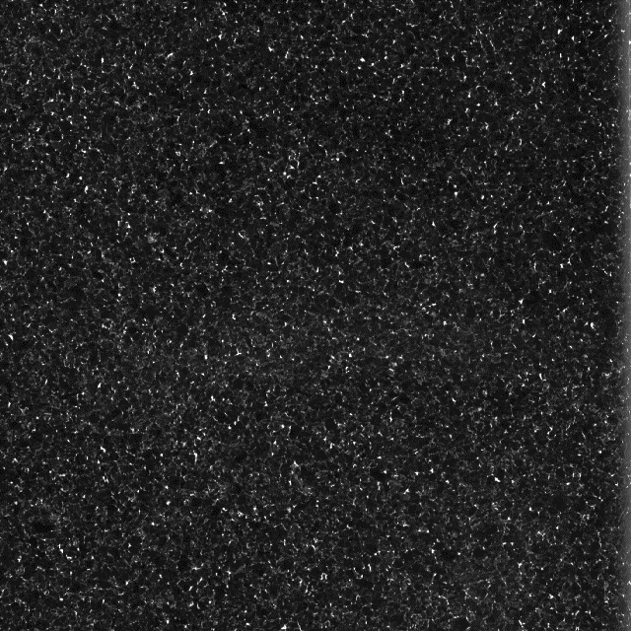
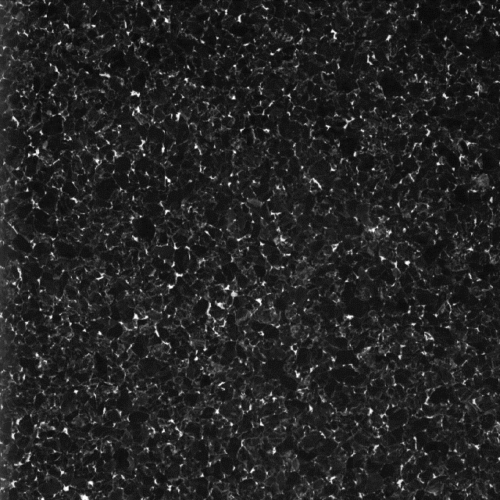
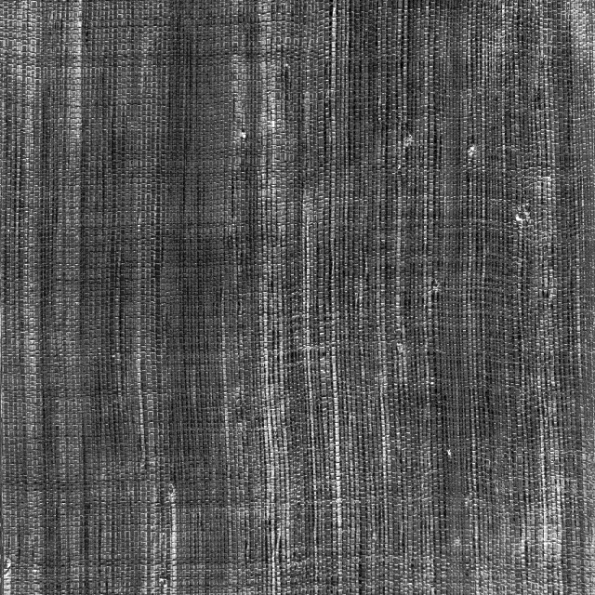
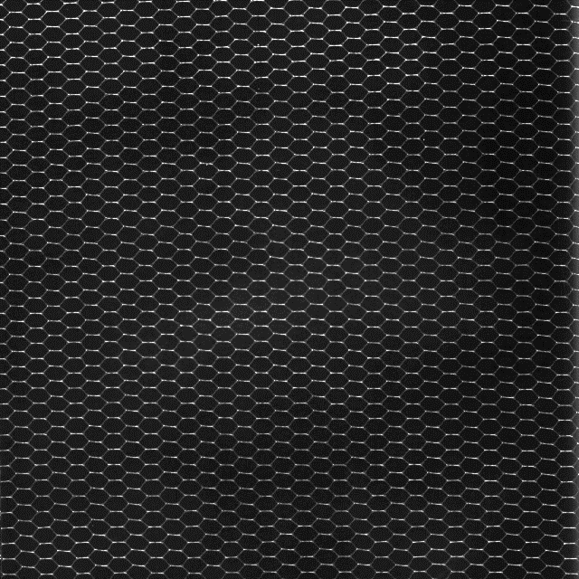
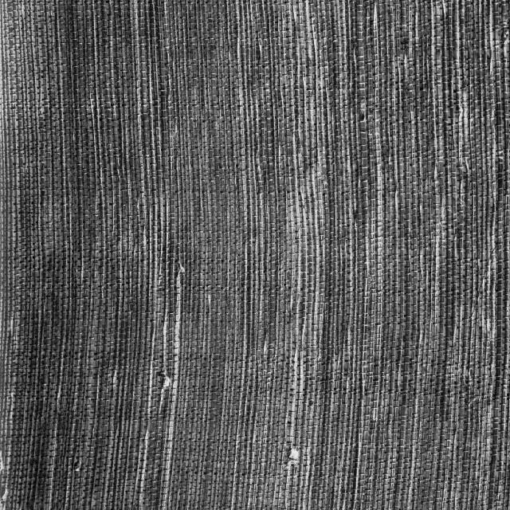
Mislabel Observations – Laplacian
32
33
39
34
32
40

Slide 17
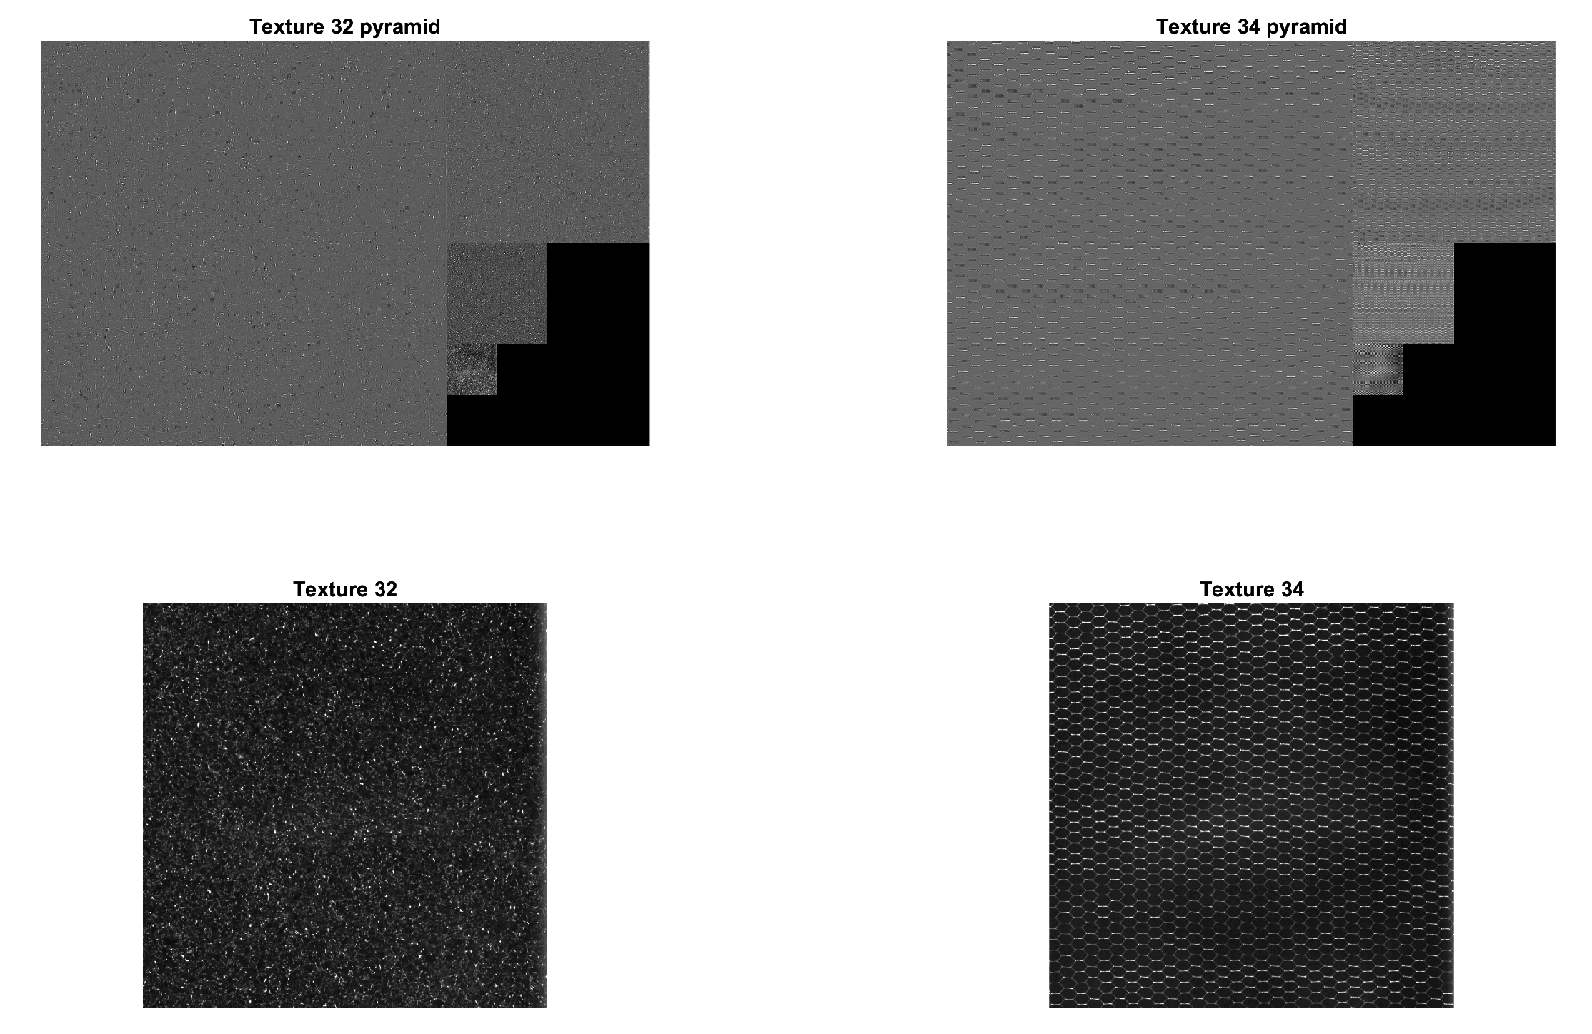
Textures and their pyramids

Slide 18
Gabor
Similar to the Laplacian, all statistics were initially used, resulting in great performance. At 4 scales and 4 orientations, the filter produced an accuracy of 85.27%.
The file “Gabor all stats all layers.txt” contains the output for each scale/orient
Testing mean only, the best PCC = 88.86% with 5 scales and 6 orientations
Testing variance only, best PCC = 79.39% with 4 scales and 4 orientations
Testing skewness only, best PCC = 59.78% accurate with 3 scales and 4 orientations
Testing kurtosis only, best PCC = 1.69% accurate at all scale and orientations

Slide 19
Gabor
Removing kurtosis due to its poor performance, the best Gabor PCC = 89.1% accurate with 4 scales and 4 orientations.
Removing Skewness as well resulted in the best Gabor PCC = 90.25% accurate with 4 scales and 4 orientations.
I tried adding in kurtosis again and re-ran the test. It had no effect on the results.
It appears that mean and variance are the most important statistics with 4 scales and 4 orientations being the optimal choice.

Slide 20
Mislabel Observations – Gabor
As with the Laplacian, I modified the code to only run at 4 scales and 4 orientations, then checked for mislabeled textures.
Texture 10 was misclassified to texture 11 a total of 55 times, the most by far.
Texture 13 was misclassified to texture 12 a total of 39 times
Texture 15 was misclassified to texture 14 a total of 26 times
As seen next slide, these textures are quite similar in structure. 10 and 11 and 13 and 12 are very structurally similar but inverted from each other.
However, I’m not sure I could tell 15 and 14 apart unless they were side-by-side as shown.

Slide 21
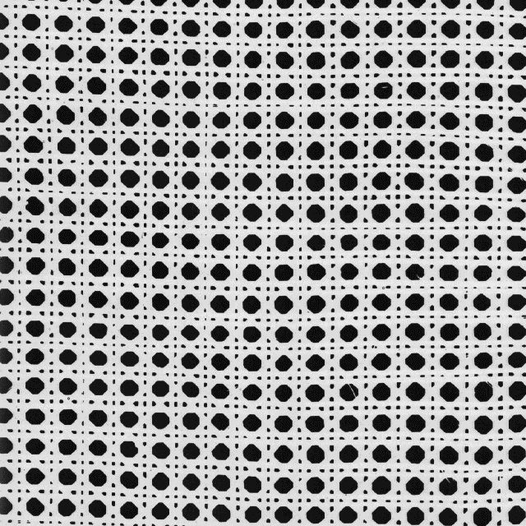
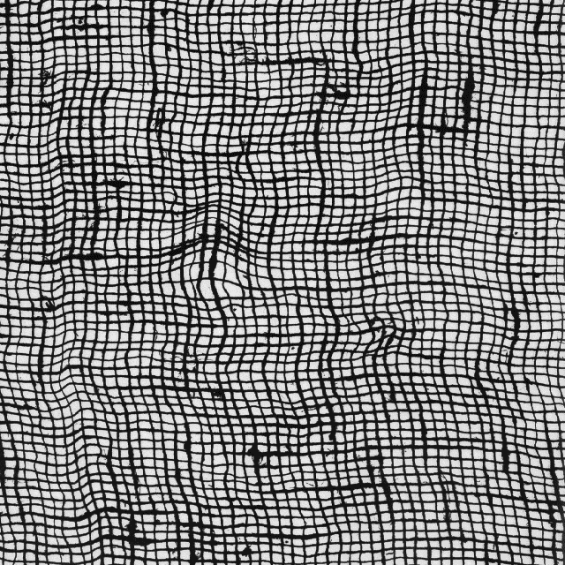
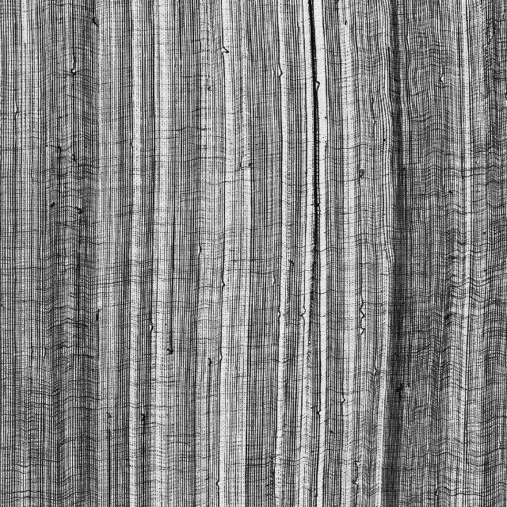
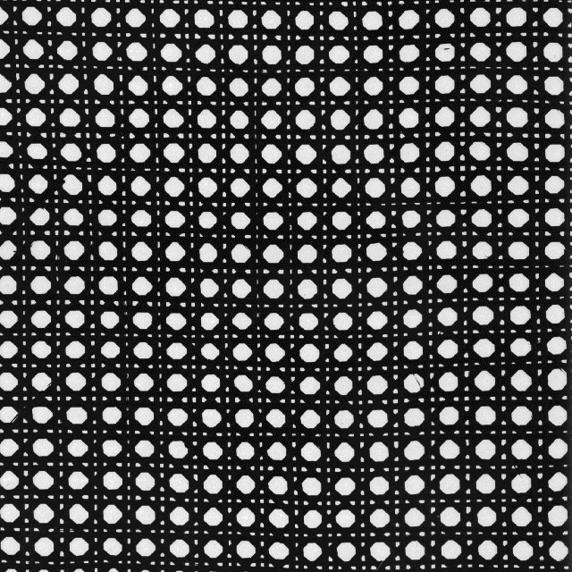
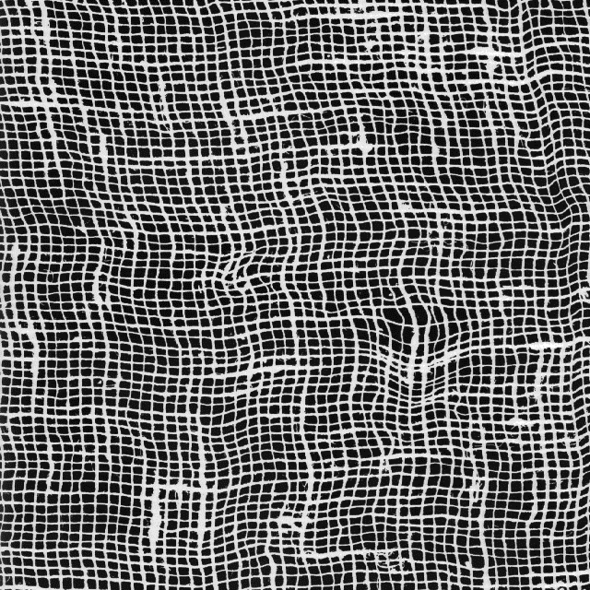
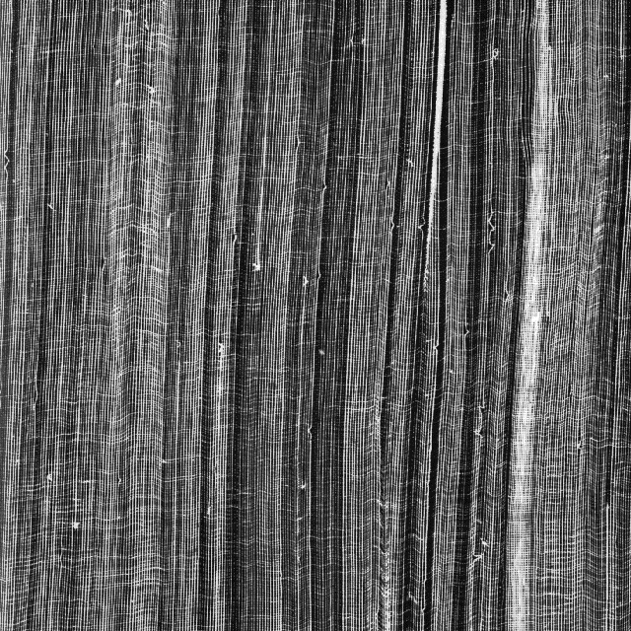
Mislabel Observations – Gabor
10
13
15
11
12
14

Slide 22
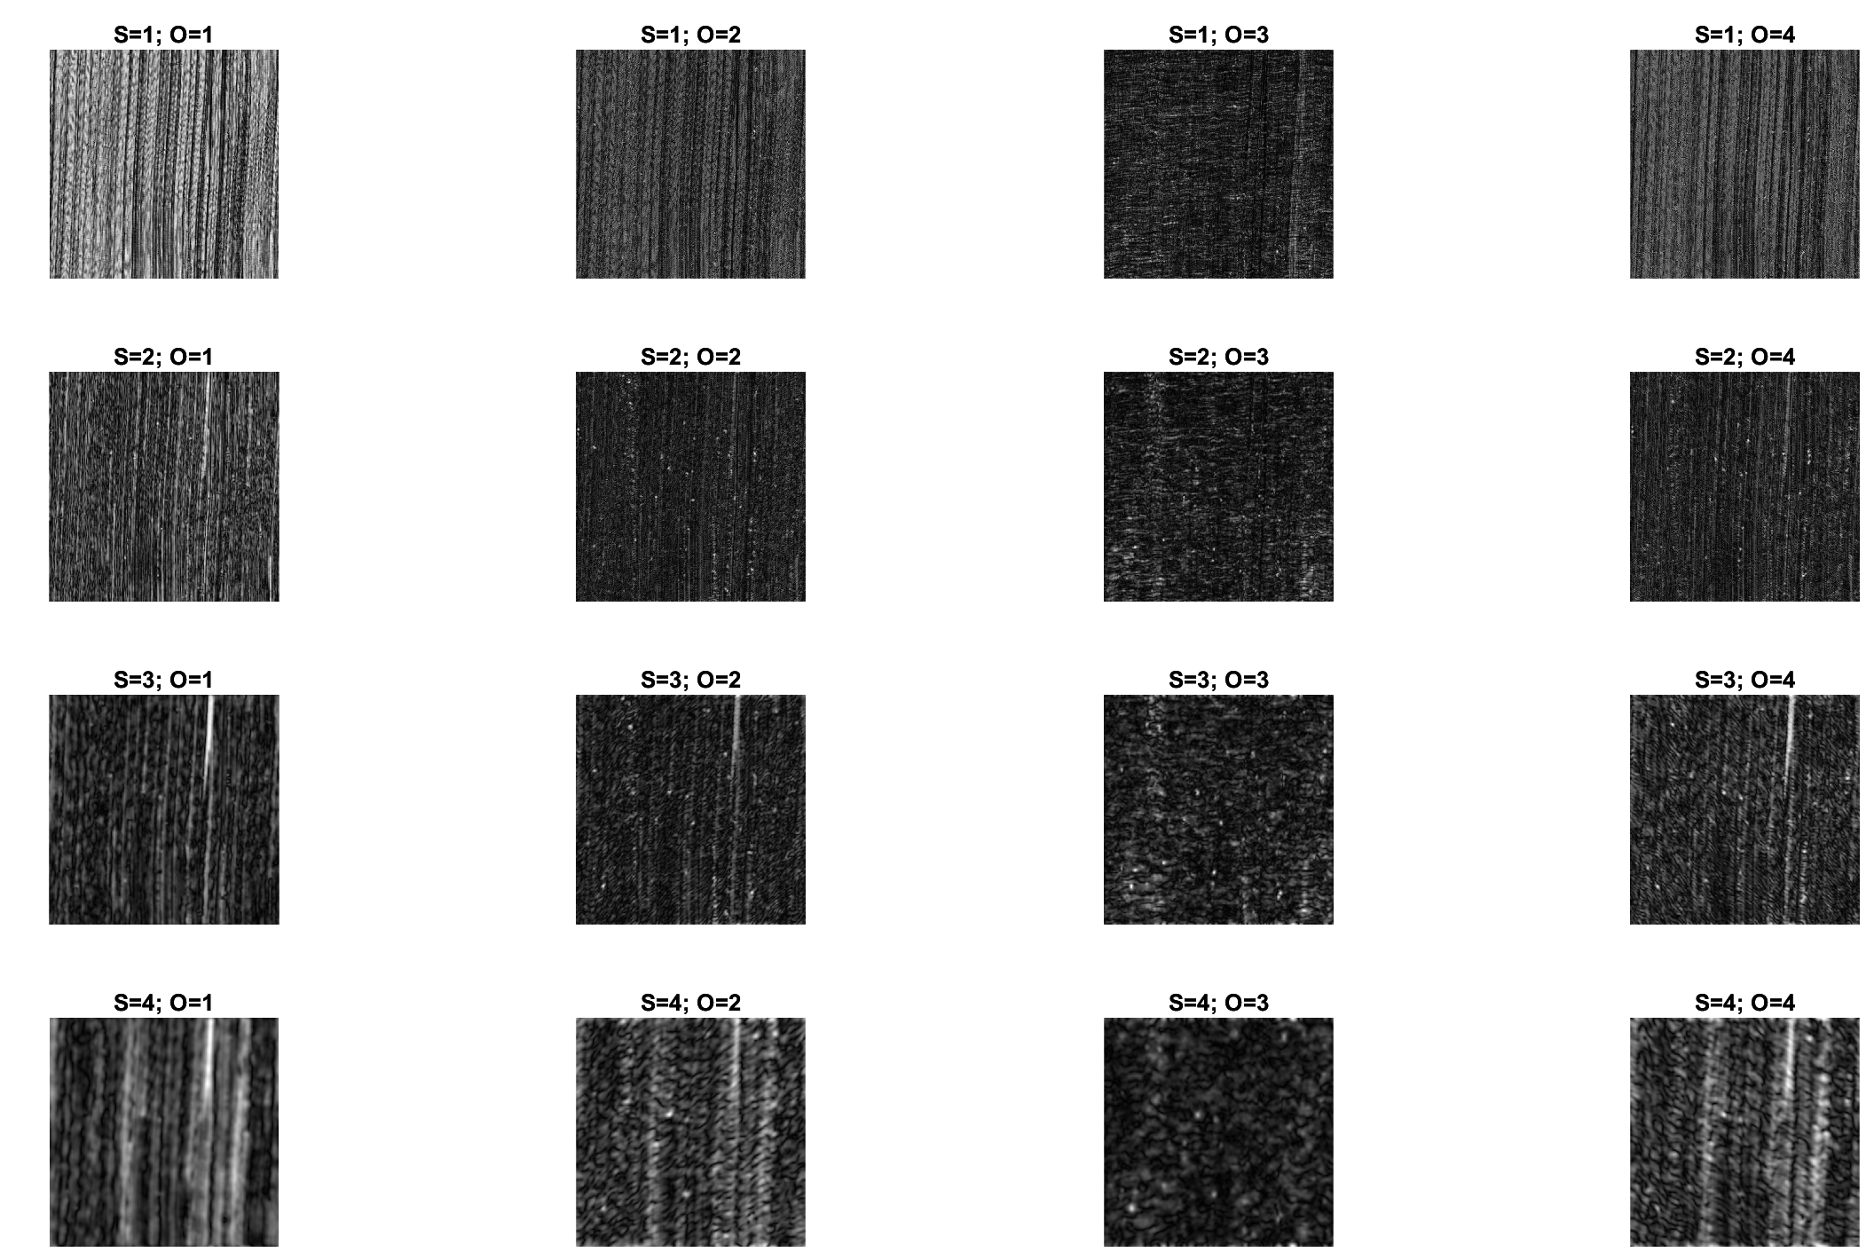
Texture 15

Slide 23
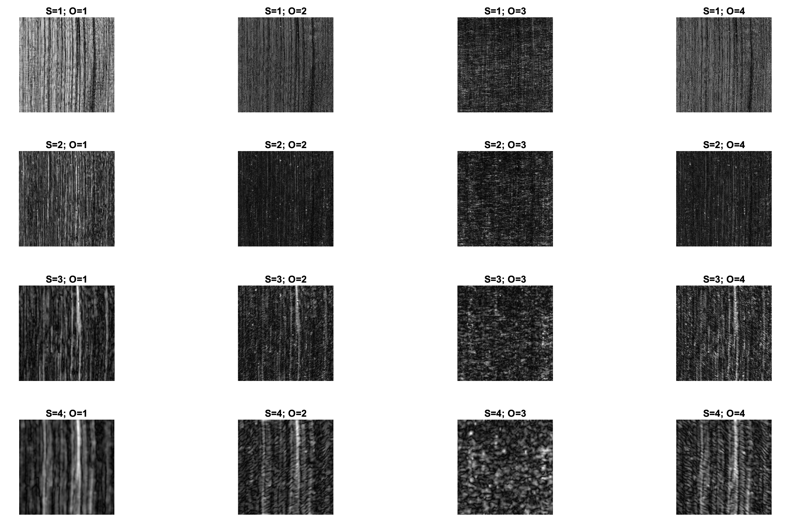
Texture 14

Slide 24
Discussion and Conclusion
Laplacian and Gabor both have good functionality, but clearly the Laplacian does not perform as well.
The Laplacian requires careful selection of the statistics with reference to each layer used while the Gabor filter was happy with only two statistics.
I expected that the Gabor filter to perform better as more scales and orientations were added; however, from the results this clearly isn’t always true.
In both cases, mean and variance are very important, but Laplacian clearly needs to factor in skewness and kurtosis to be effective while Gabor seems to suffer from both being included in the calculations.

Slide 25
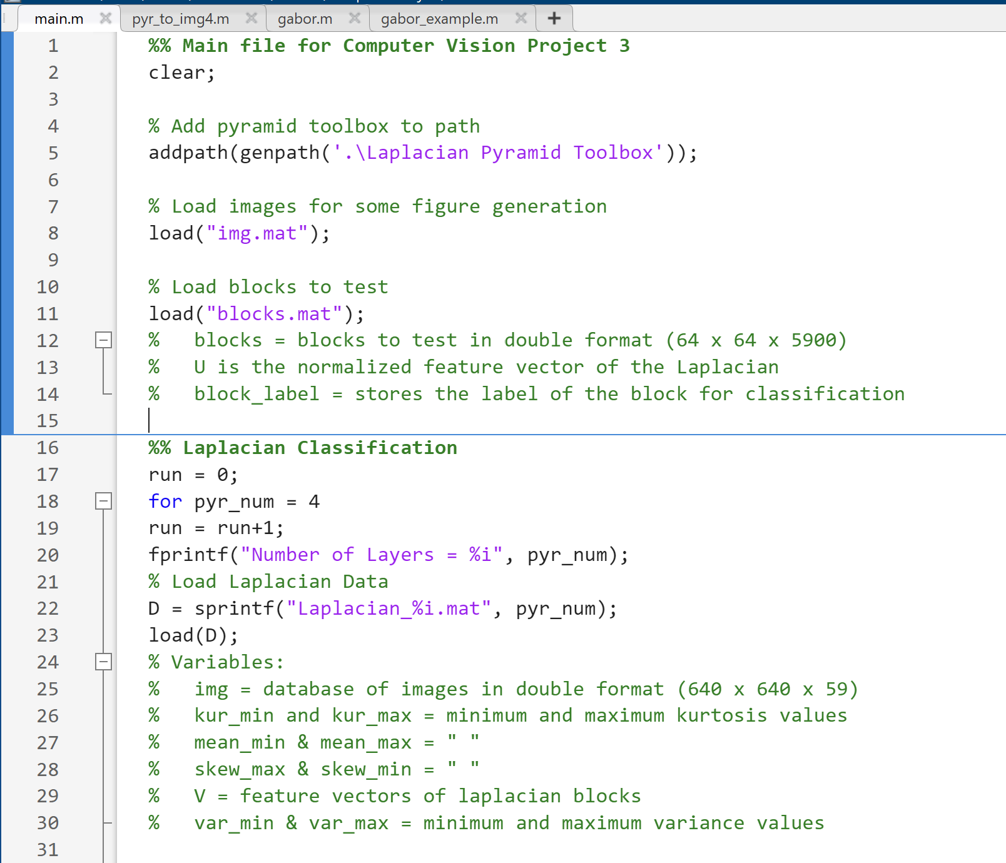
Appendix – Code – Main file

Slide 26
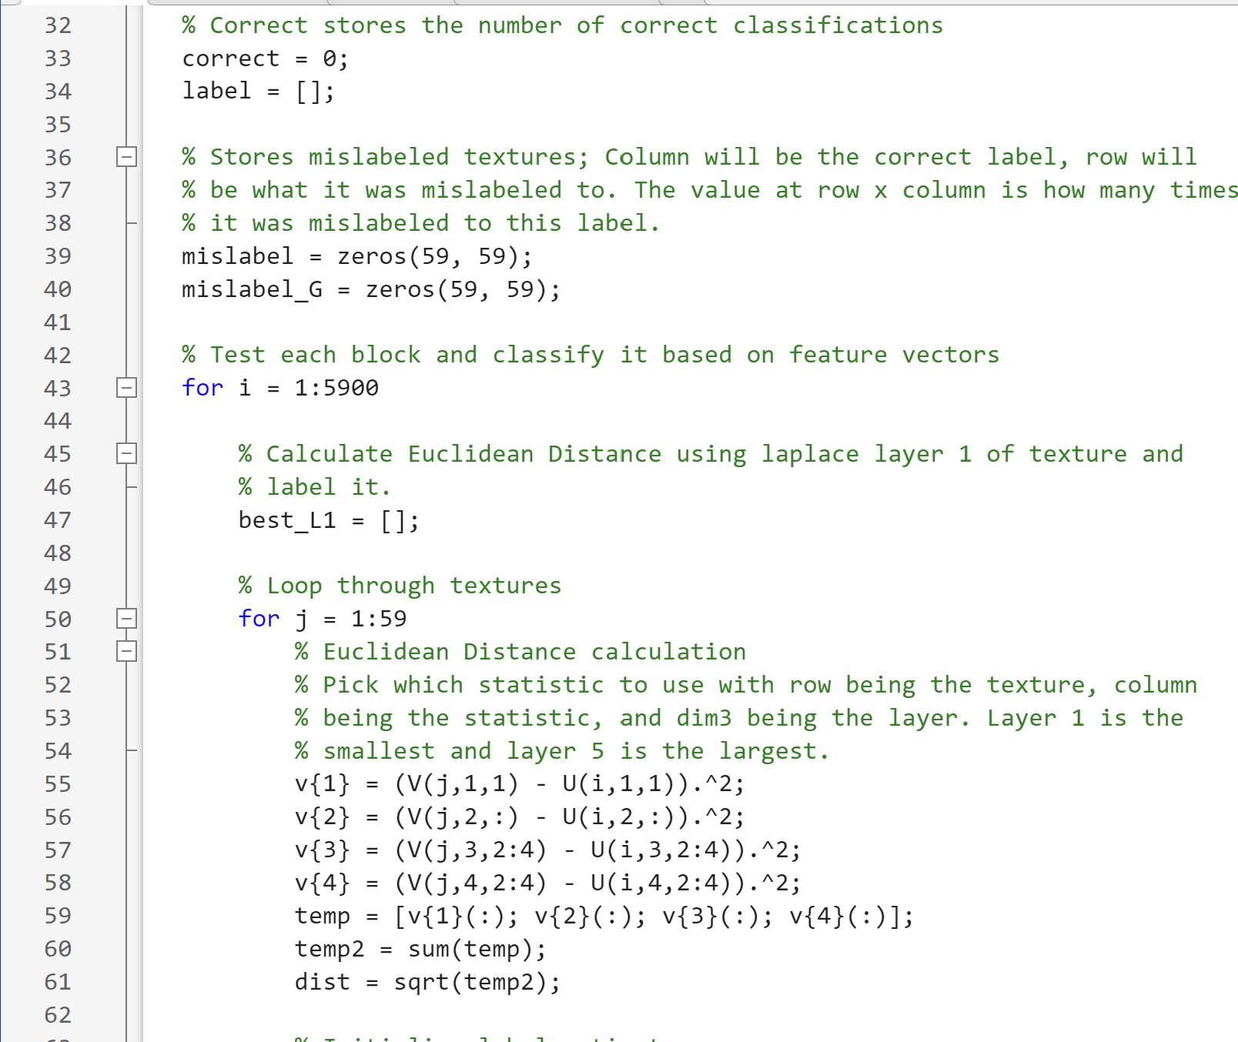
Appendix – Code – Main

Slide 27
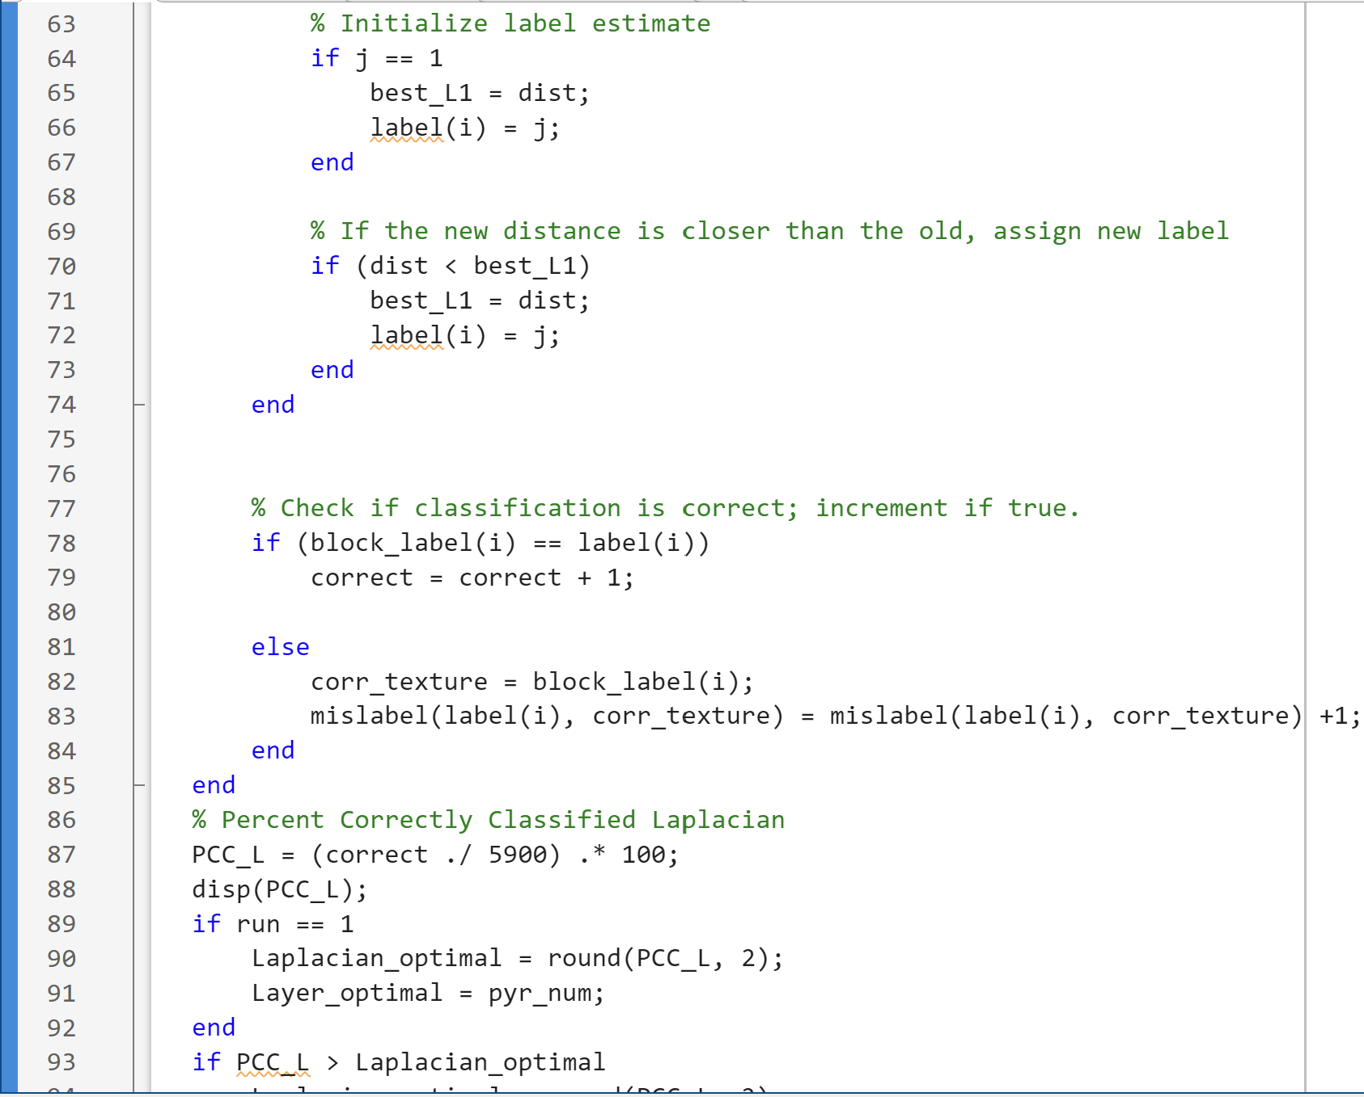
Appendix – Code – Main

Slide 28
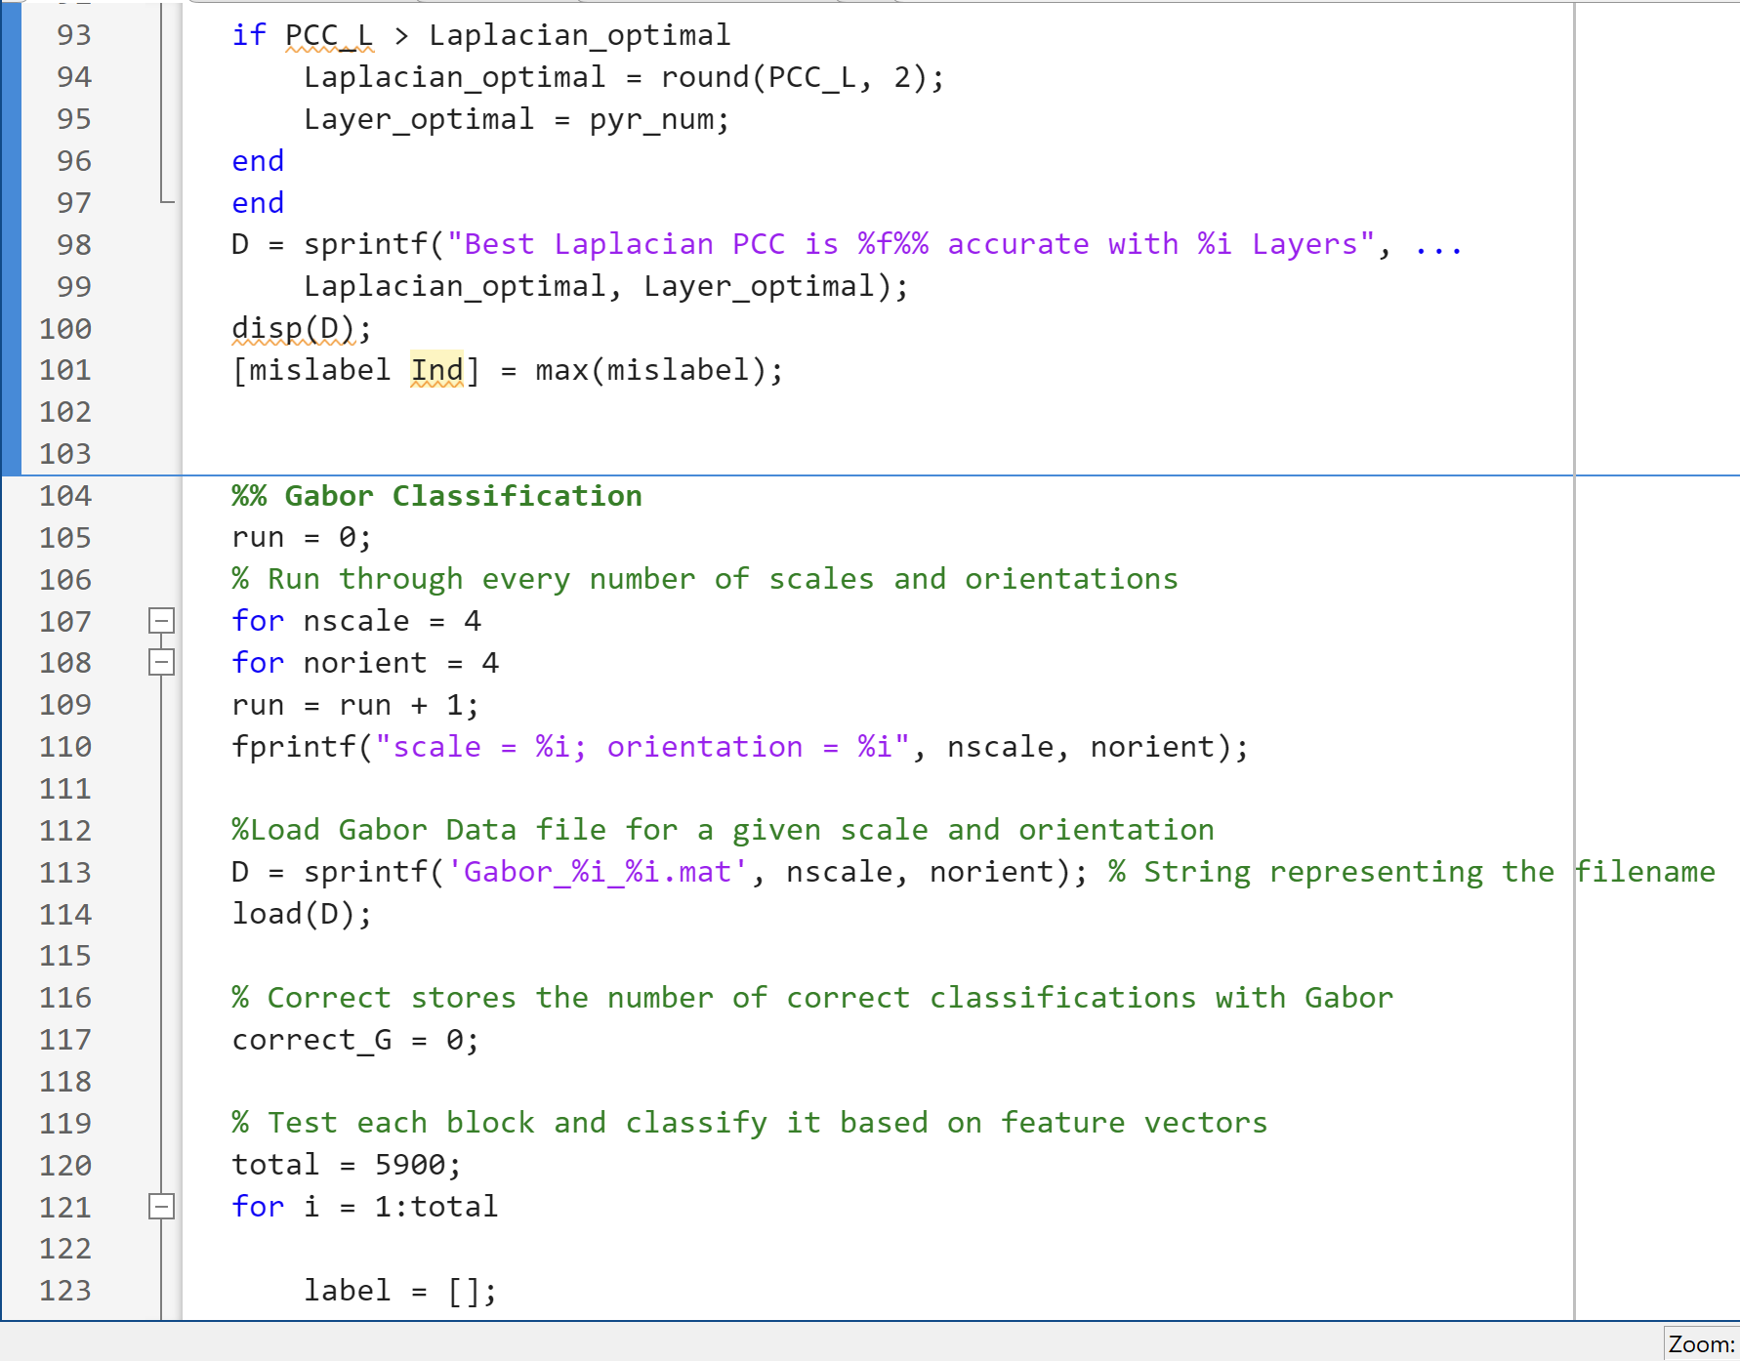
Appendix – Code – Main

Slide 29
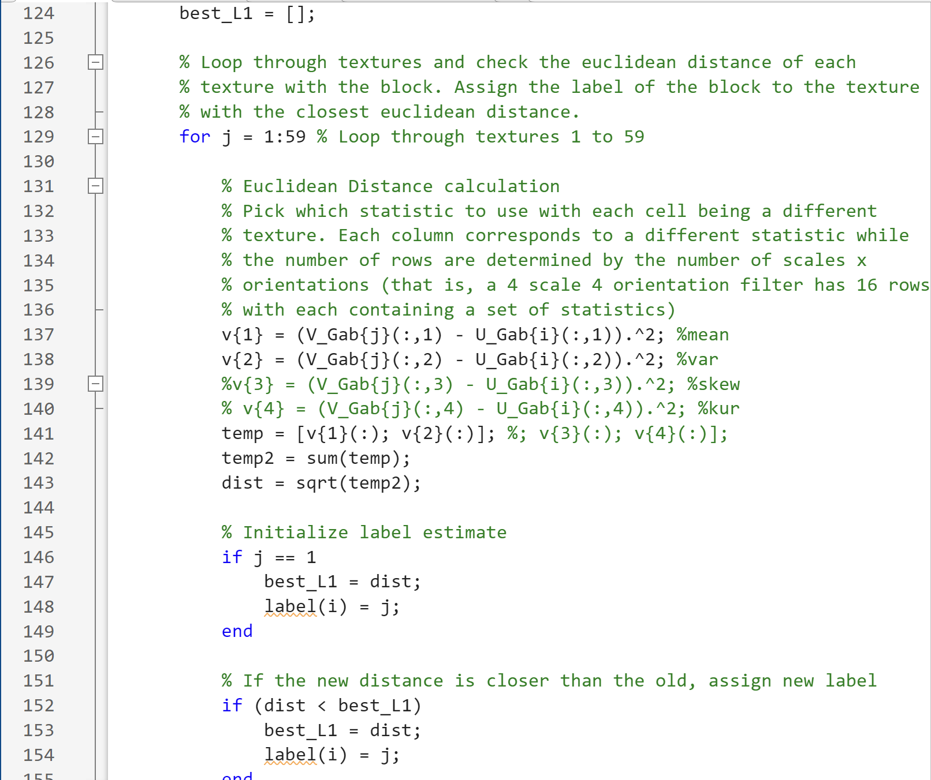
Appendix – Code – Main

Slide 30
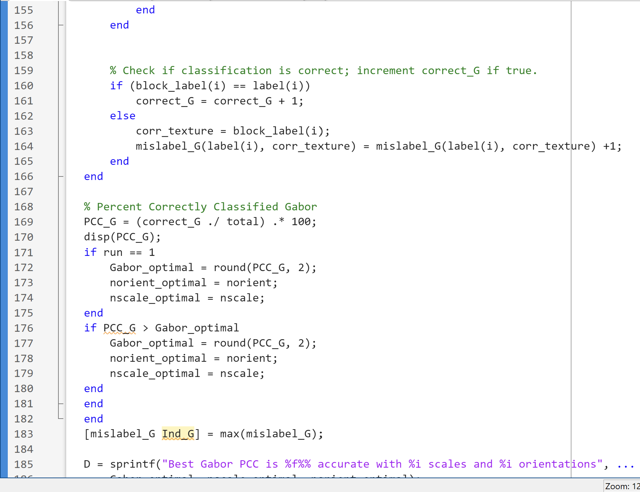
Appendix – Code – Main

Slide 31
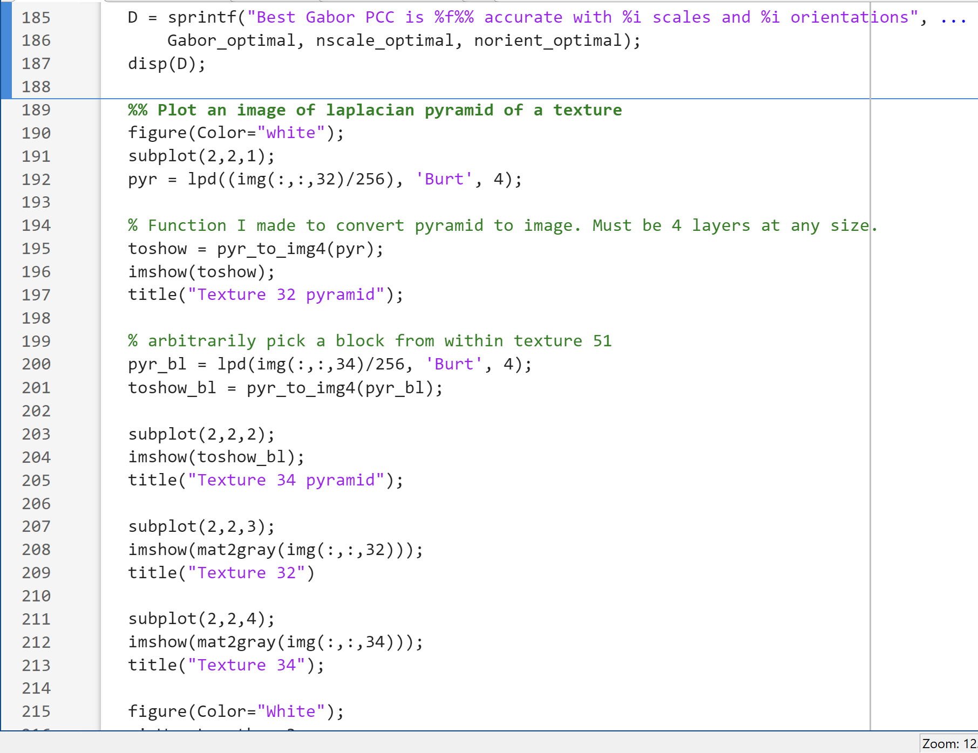
Appendix – Code – Main

Slide 32
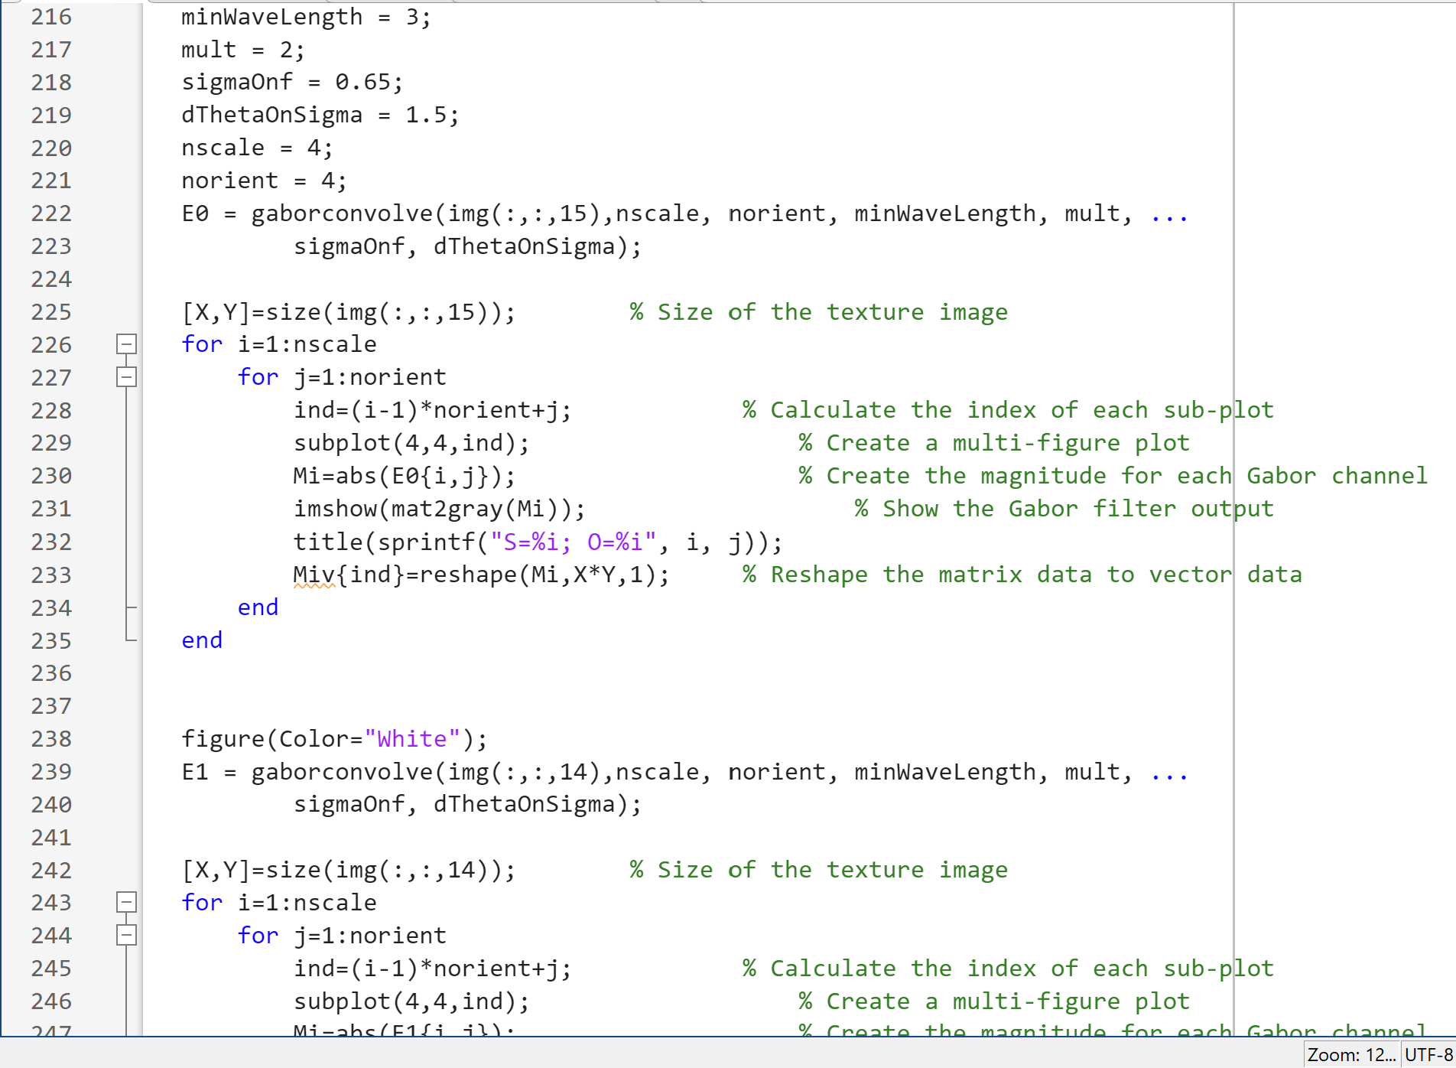
Appendix – Code – Main

Slide 33
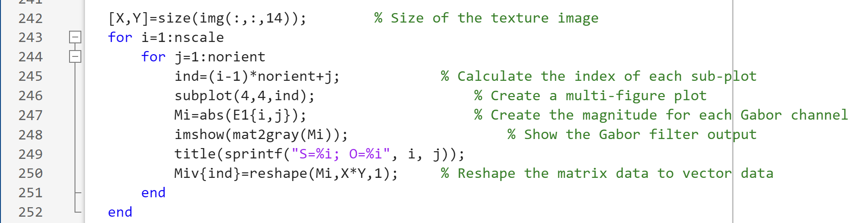
Appendix – Code – Main

Slide 34
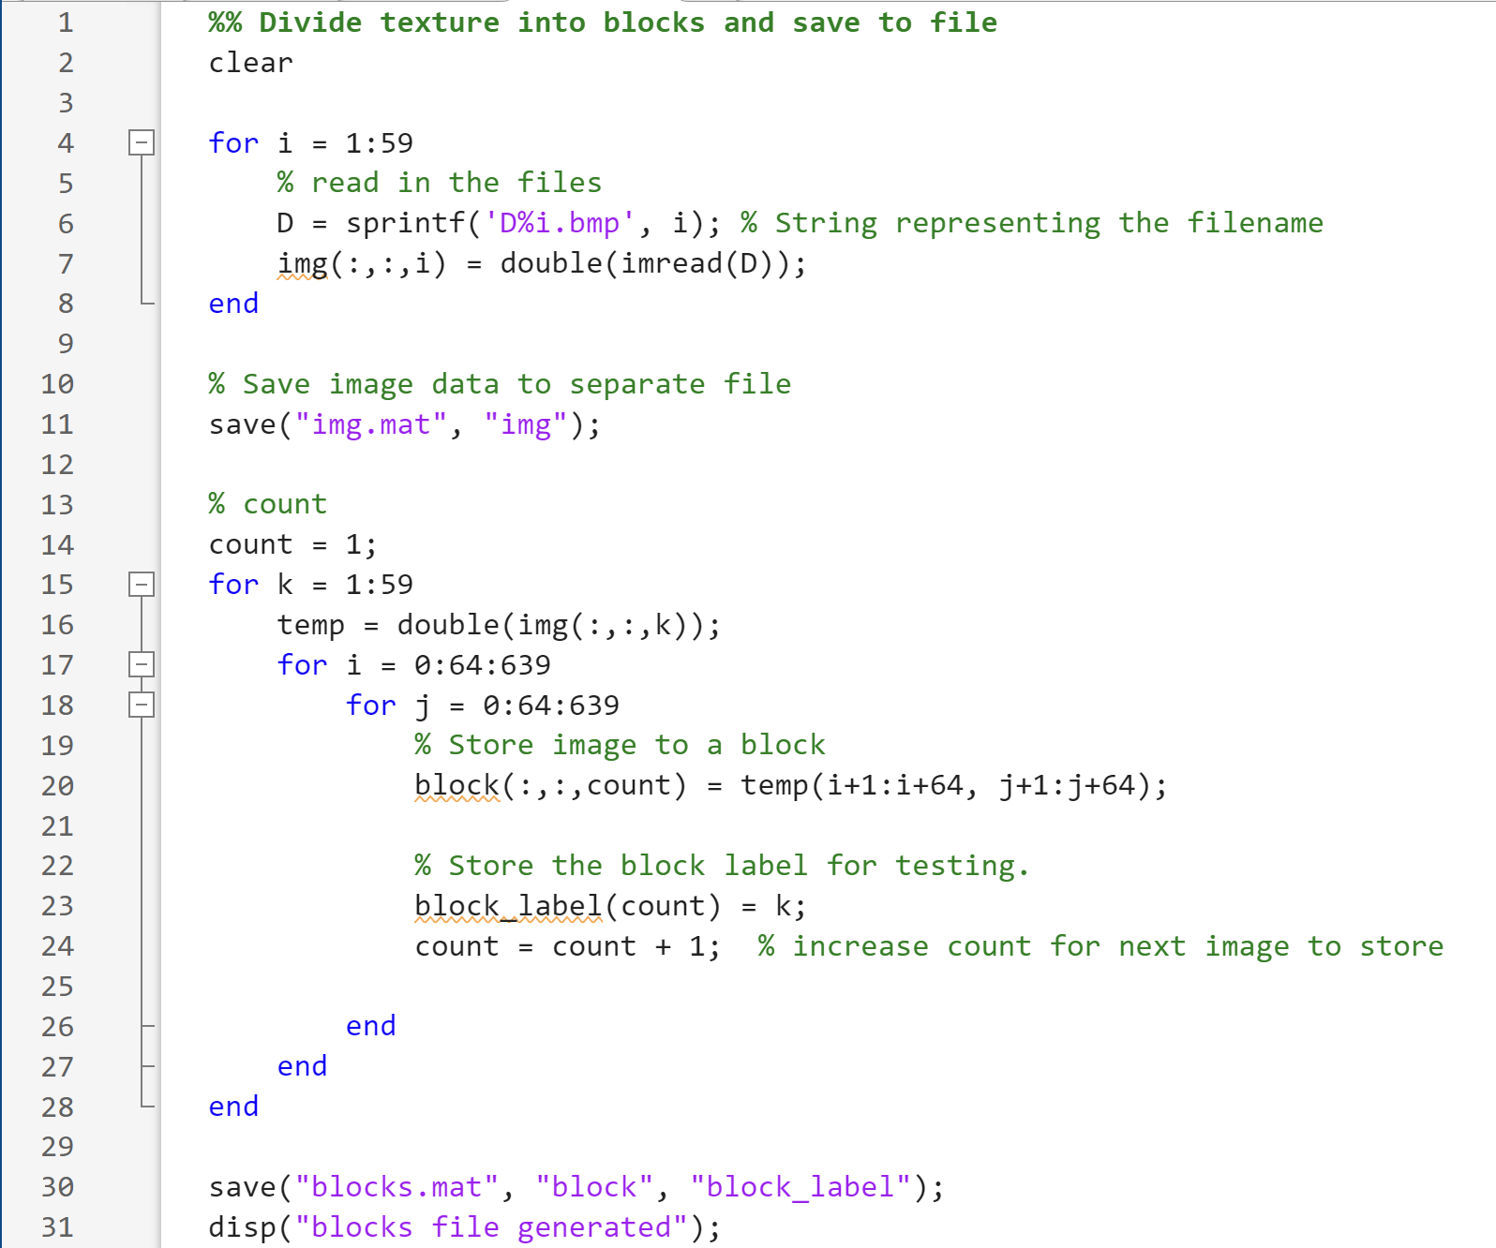
Appendix – Code – Blocks.m

Slide 35
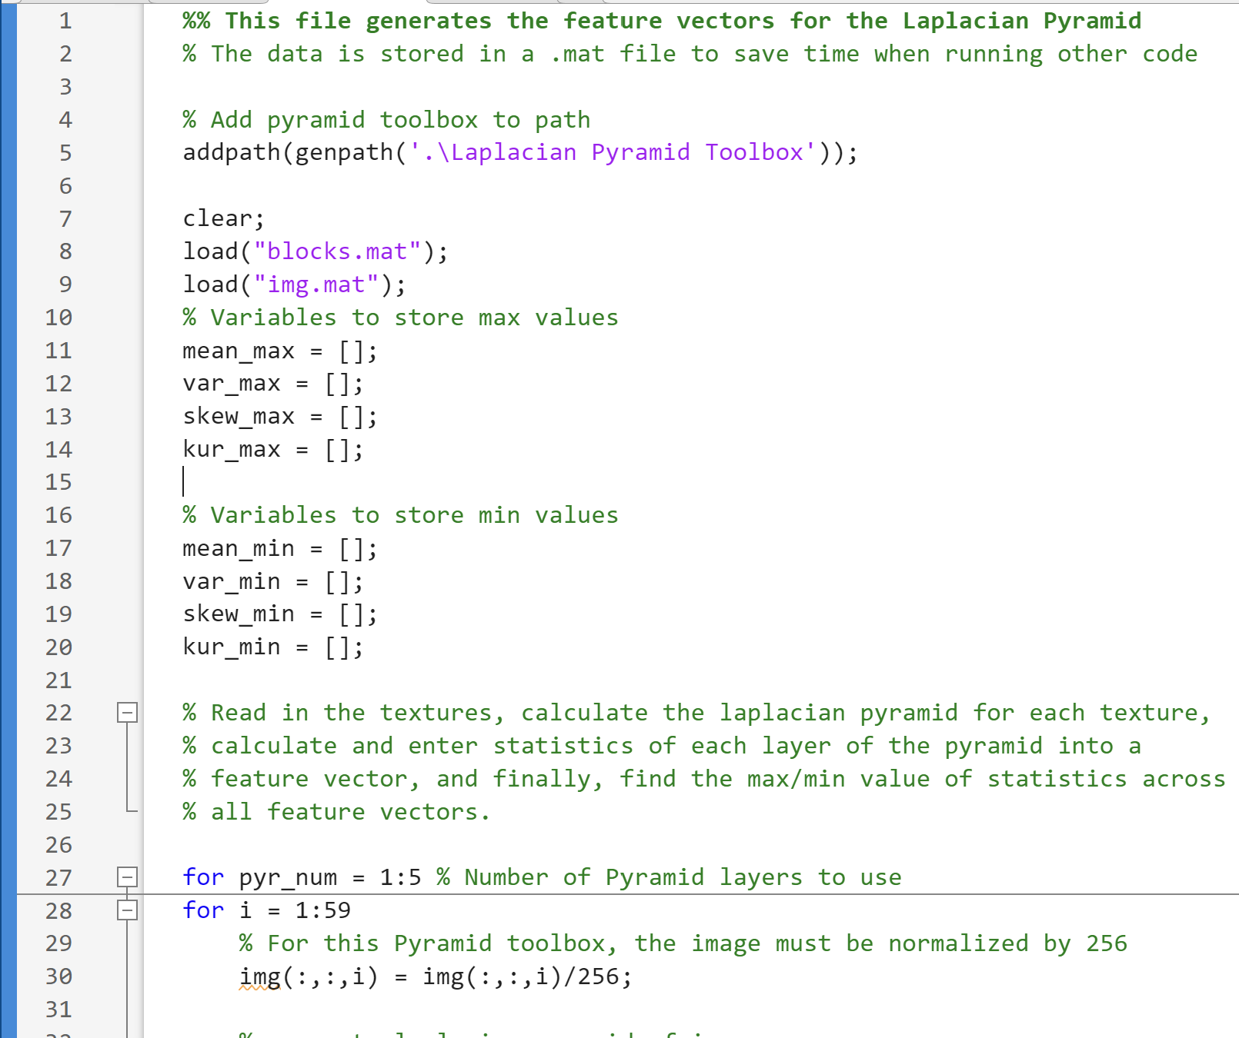
Appendix – Code – Laplacian

Slide 36
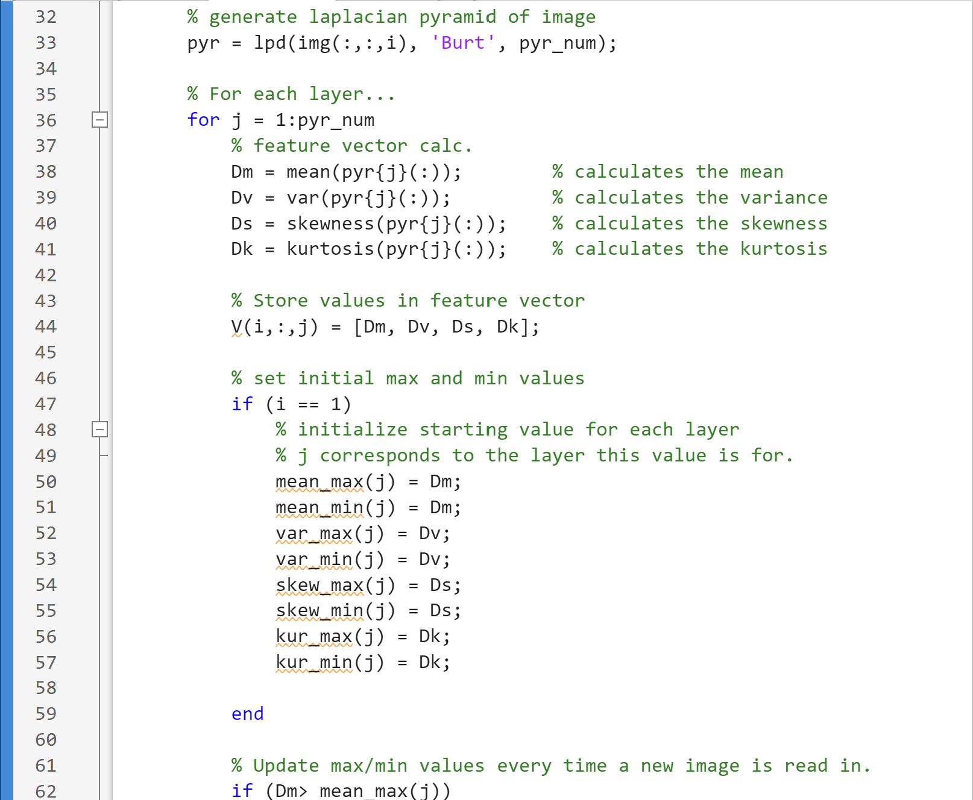
Appendix – Code – Laplacian

Slide 37
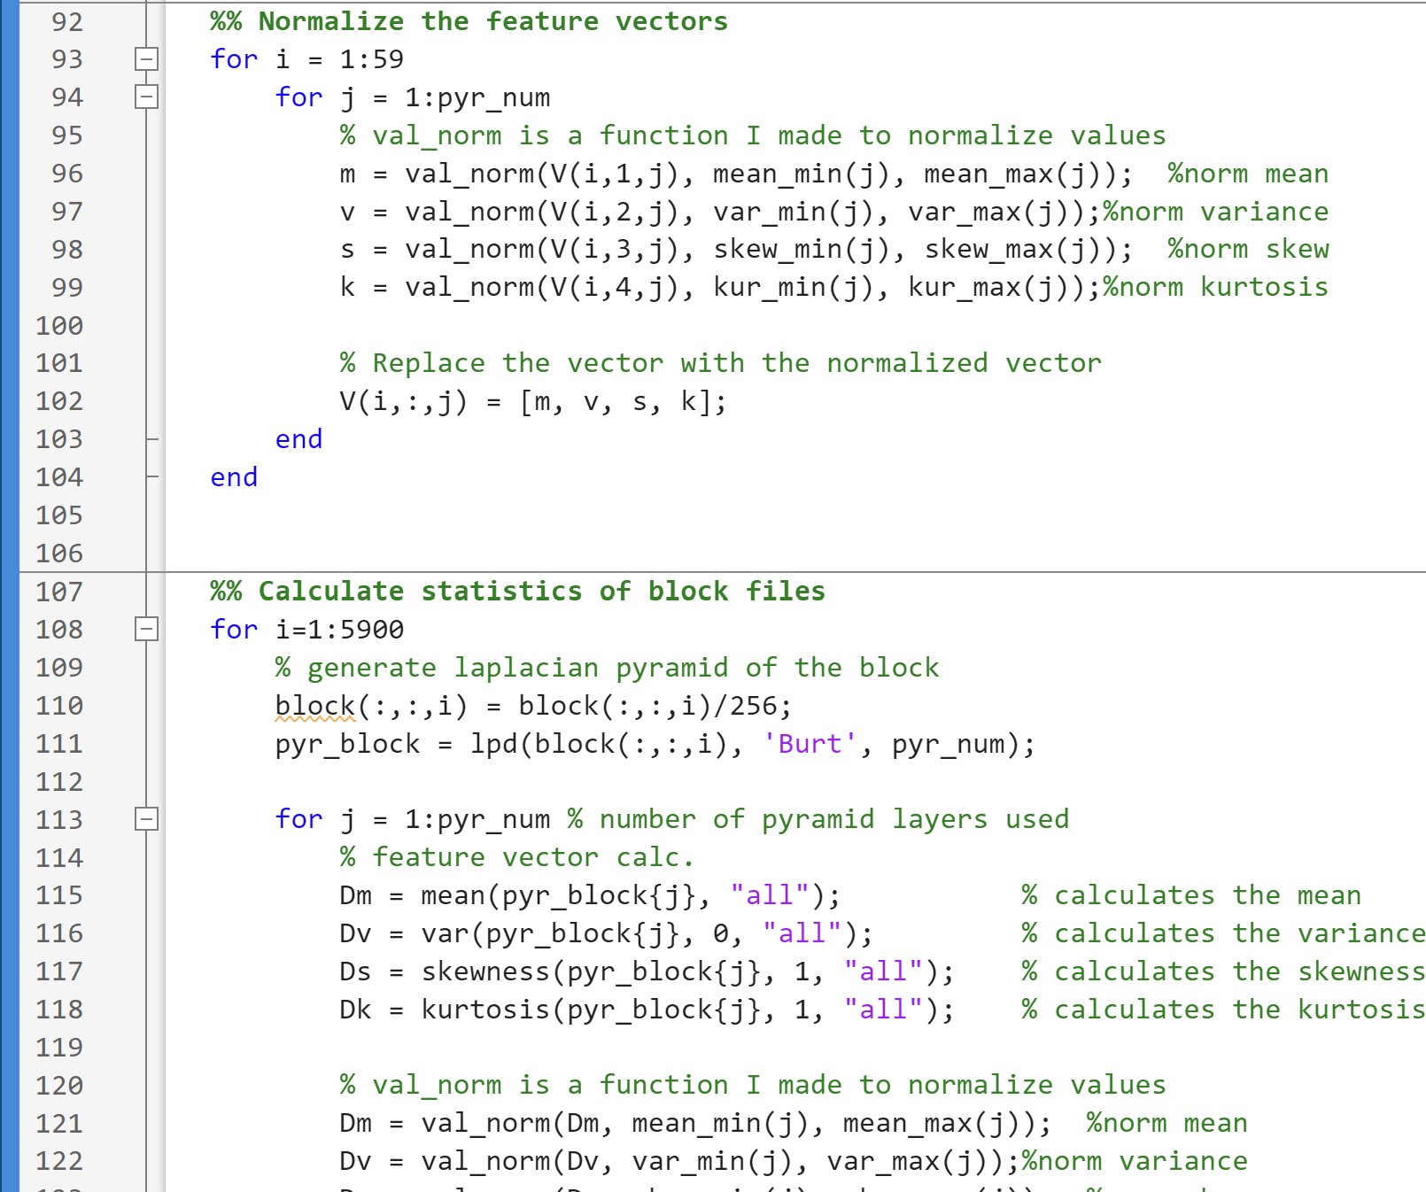
Appendix – Code – Laplacian

Slide 38
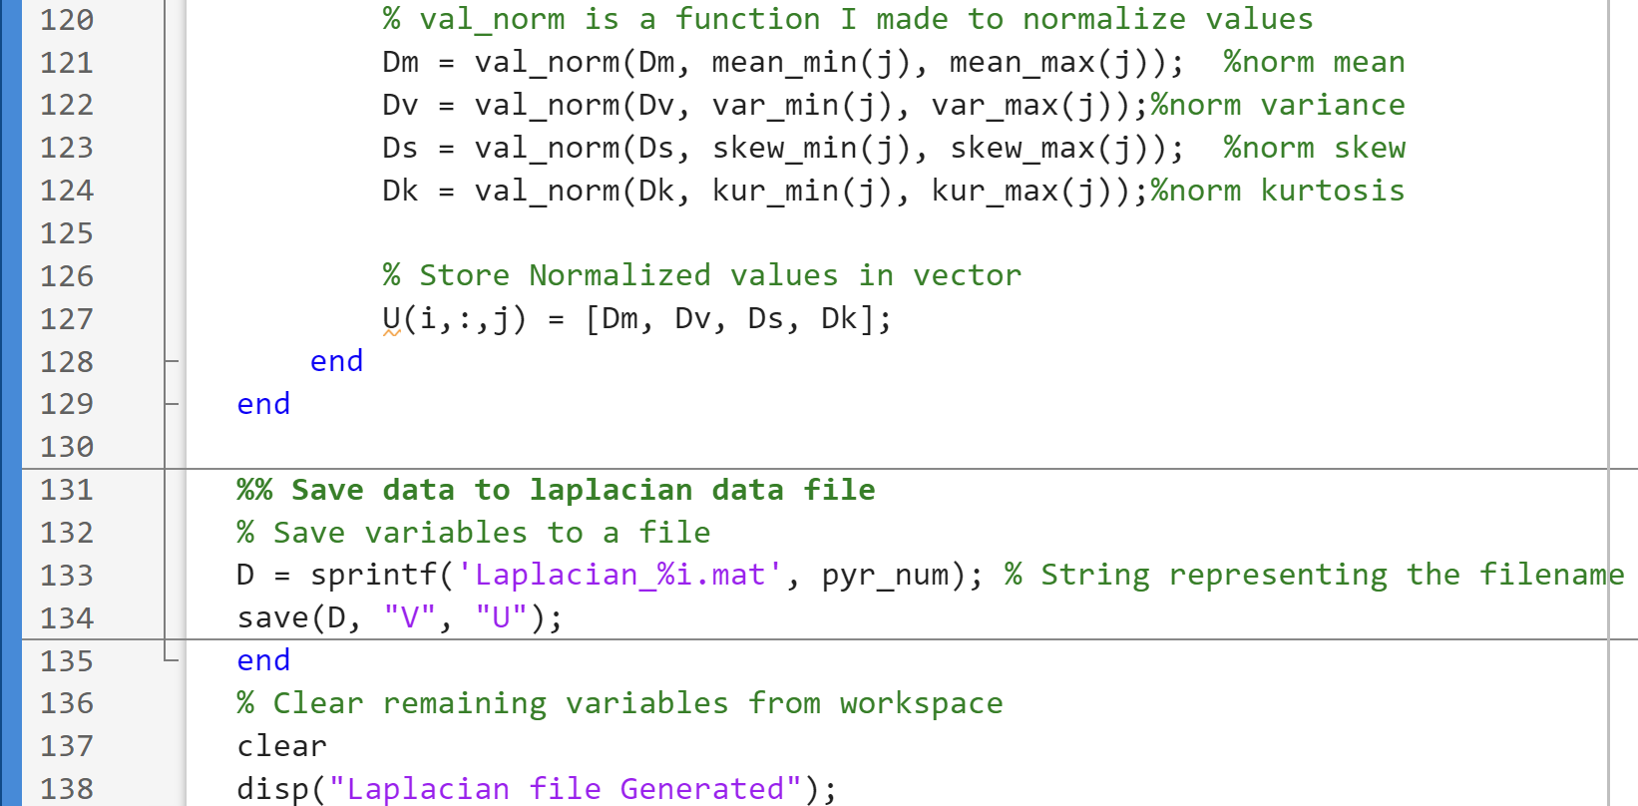
Appendix – Code – Laplacian

Slide 39
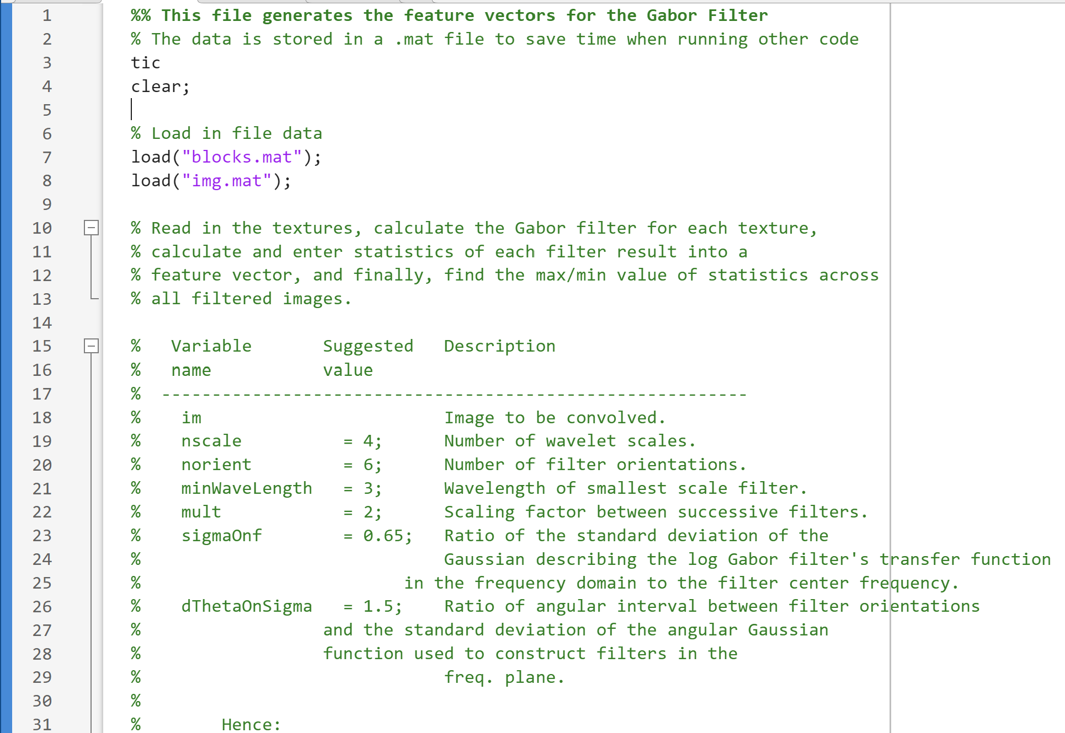
Appendix – Code – Gabor

Slide 40
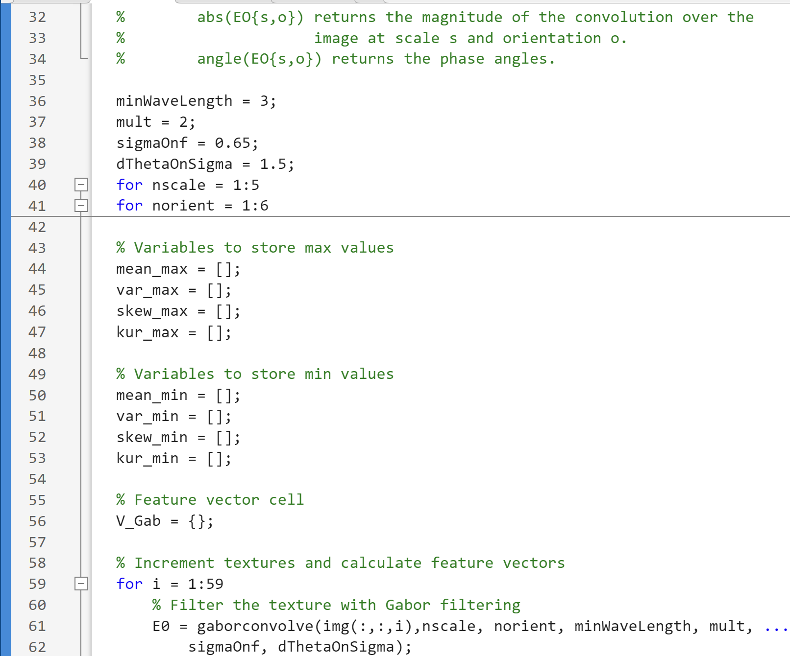
Appendix – Code – Gabor

Slide 41
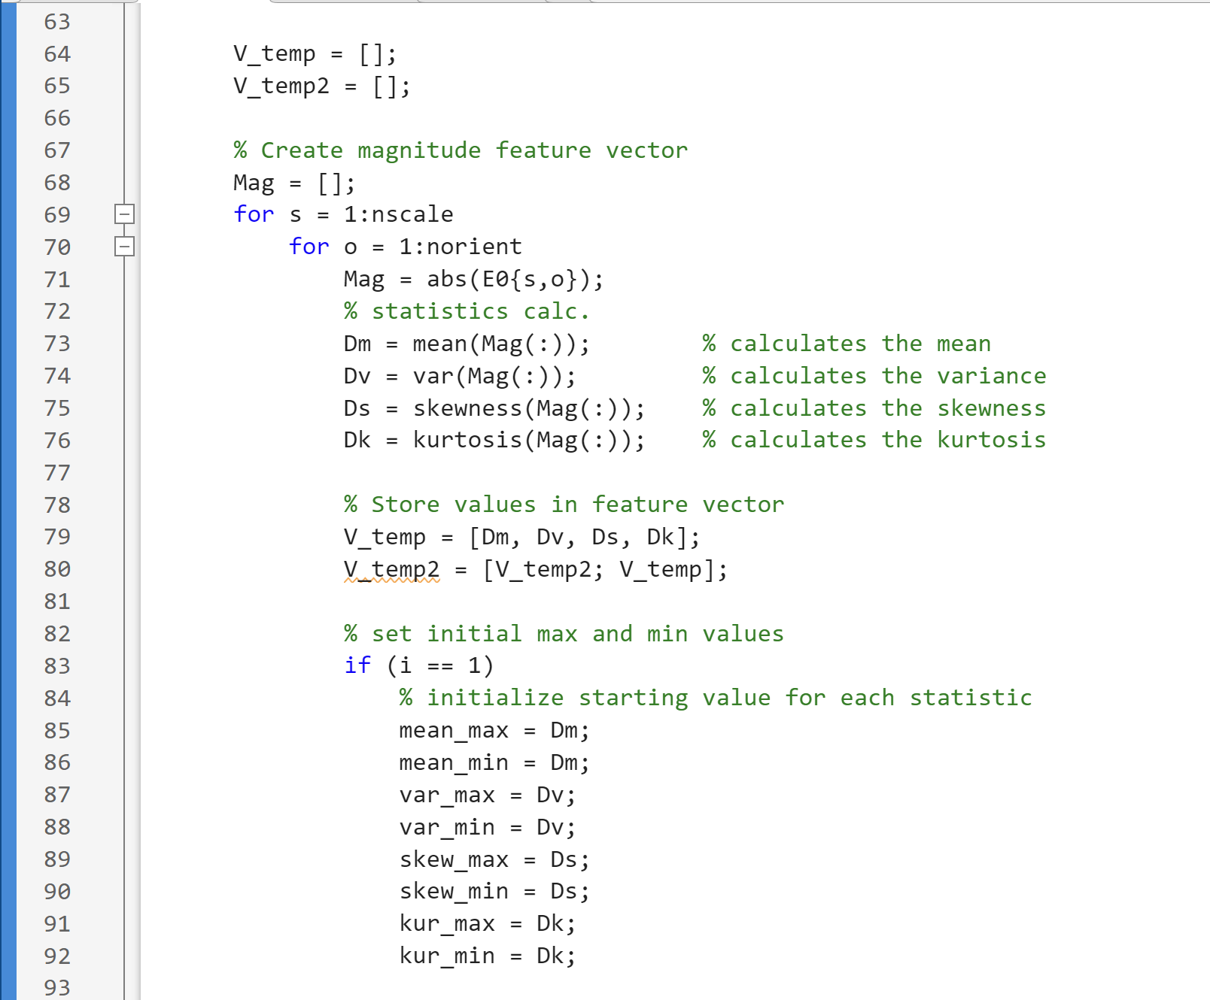
Appendix – Code – Gabor

Slide 42
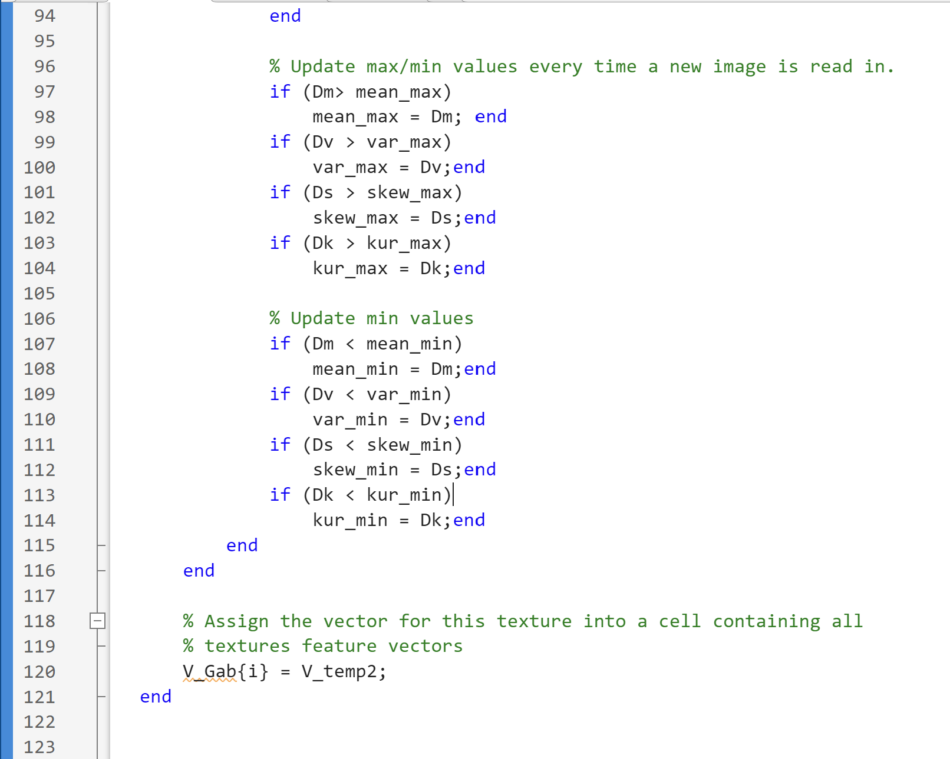
Appendix – Code – Gabor

Slide 43
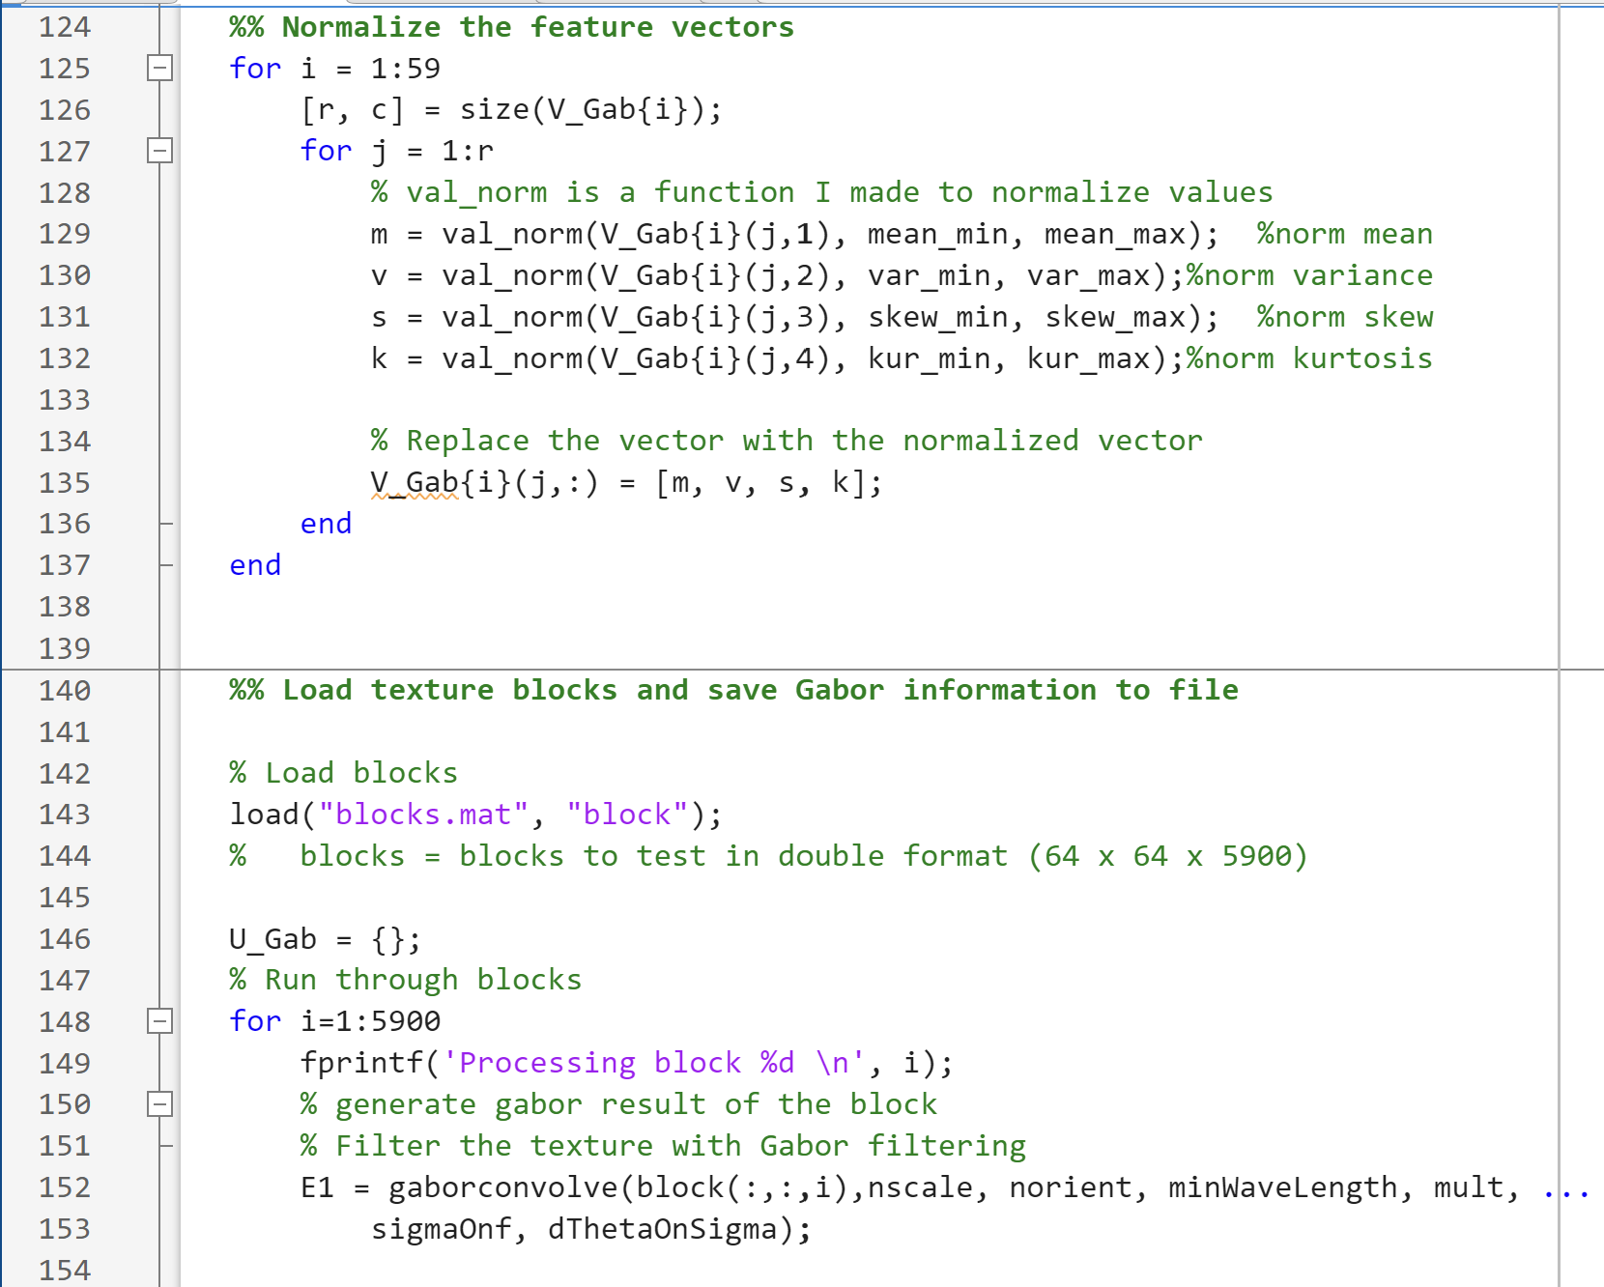
Appendix – Code – Gabor

Slide 44
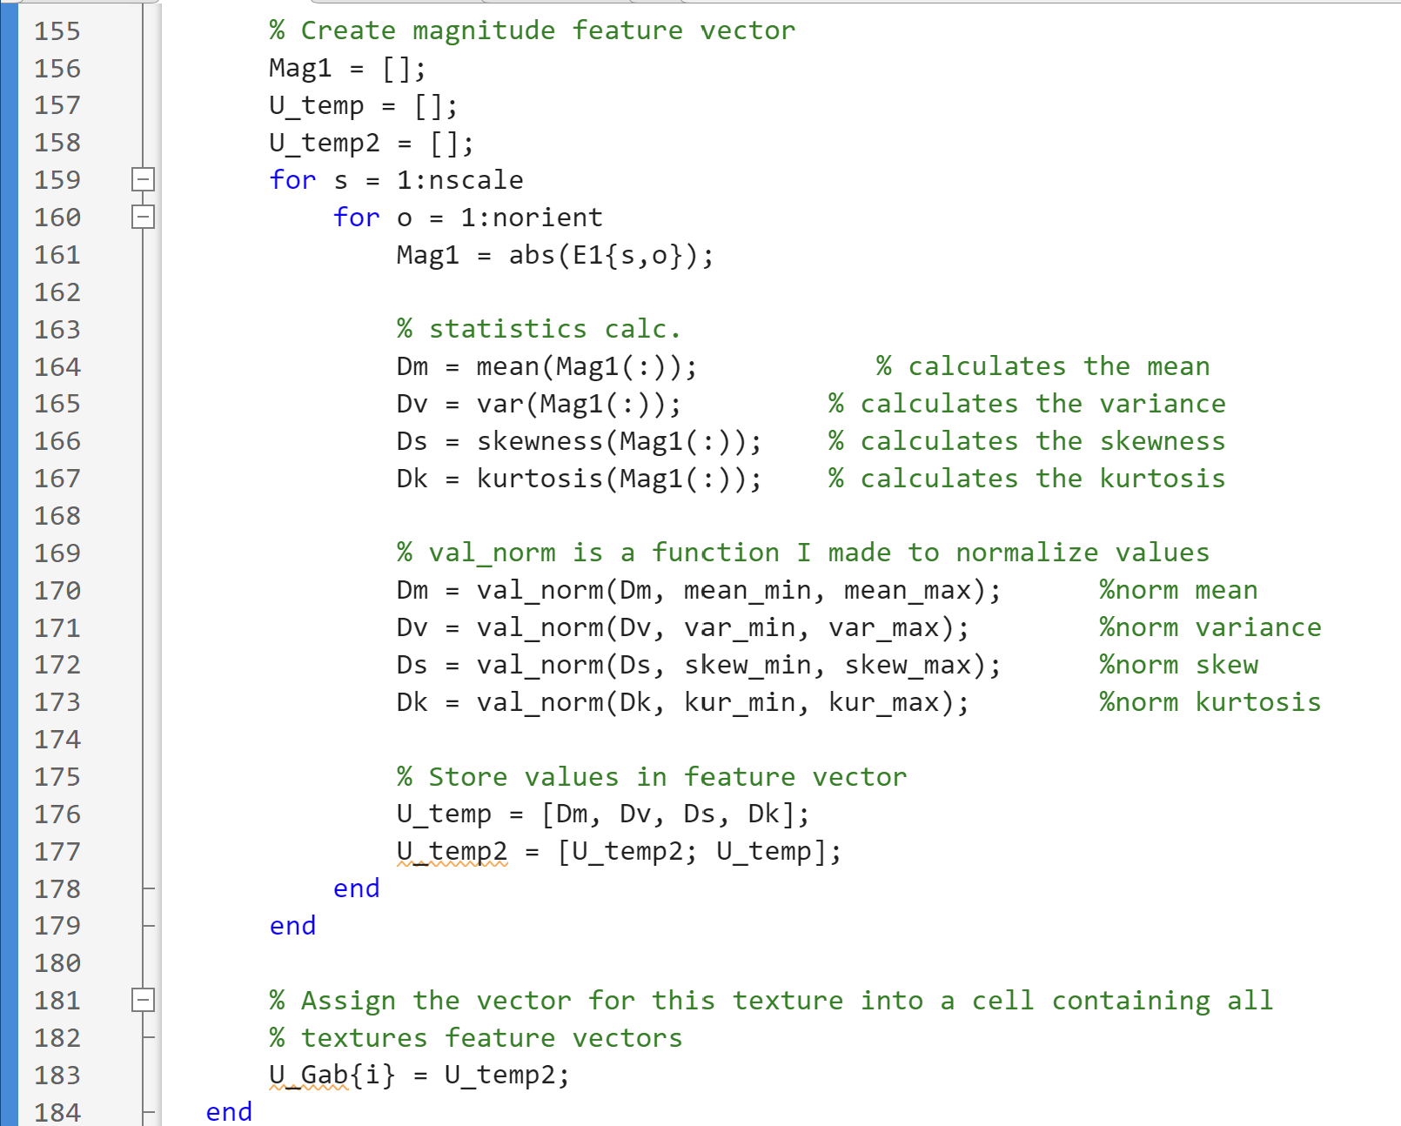
Appendix – Code – Gabor

Slide 45
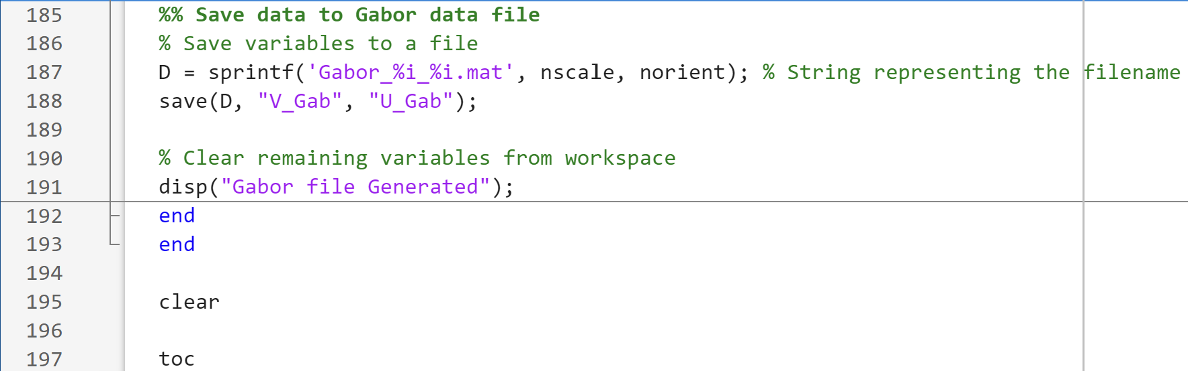
Appendix – Code – Gabor

